Slide 1
Famous Renaissance Writers

Slide 2
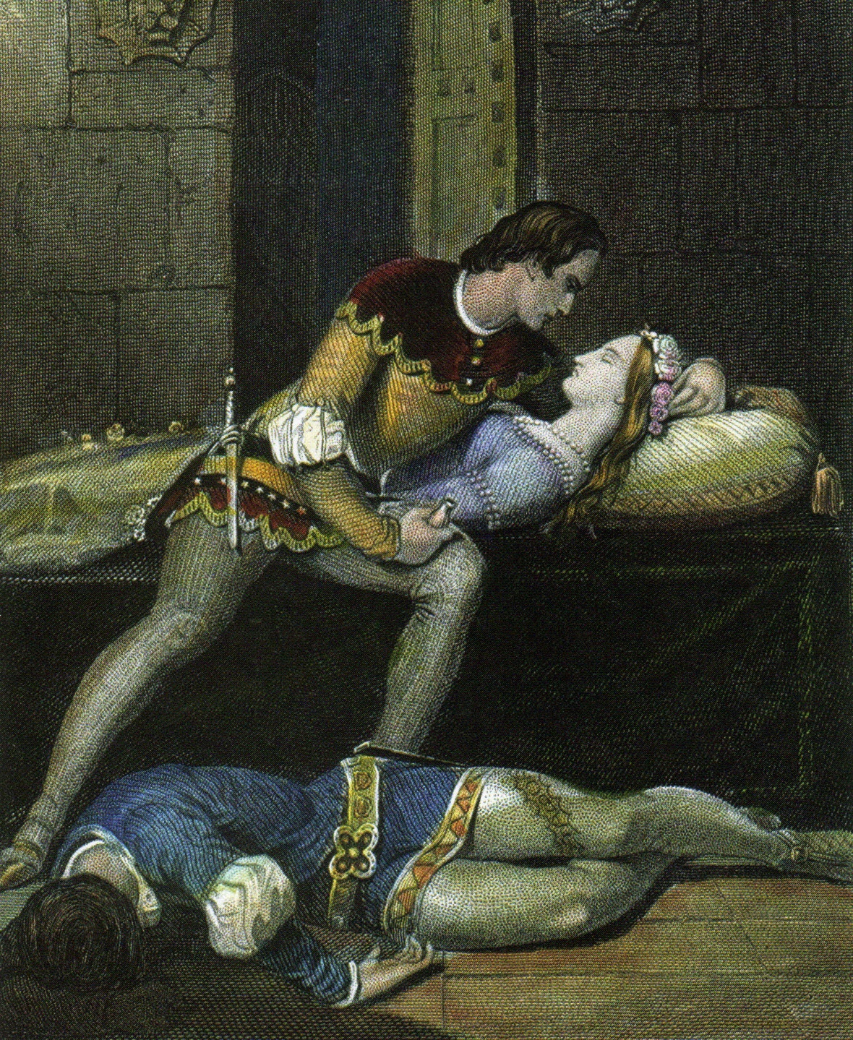
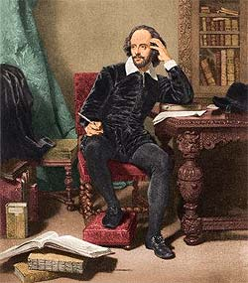
William Shakespeare
actor, poet, and playwright
good way with words and understanding of human behavior
wrote 38 plays and poetry

Slide 3
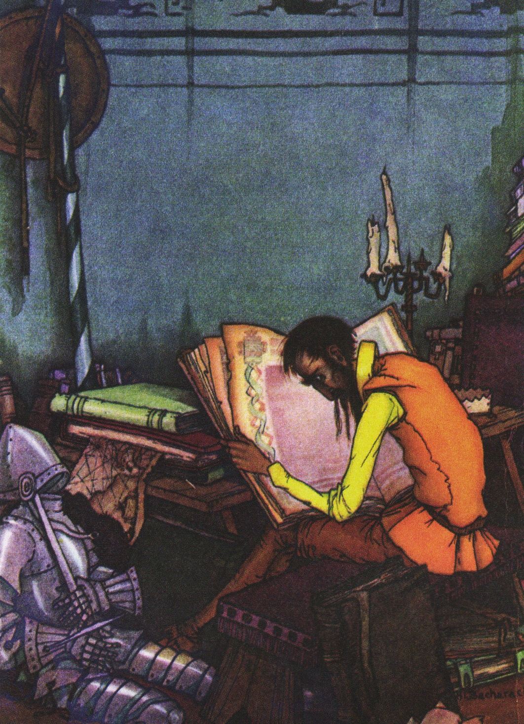
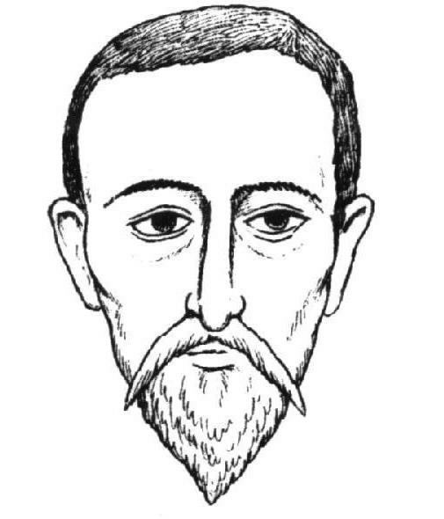
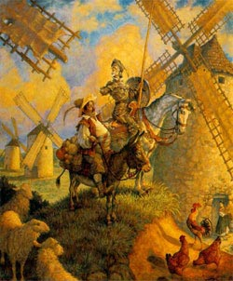
Don Quixote is a brilliant satire
Miguel Cervantes
gifted writer with talent for satire
wrote many plays, poems, and novels
wrote Don Quixote, a satire that poked fun at Spanish society

