Slide 1
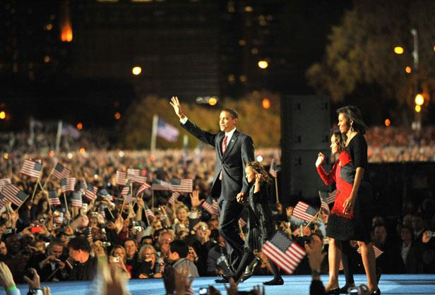
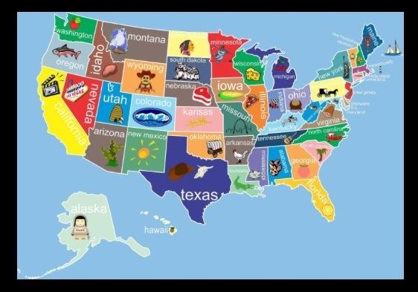
After observing the documents and images of _____________, it is clear that the elements of PERSIG are _________________ as shown by __________________________
_____________, ________________ as shown by ______________________ and ____________________ as illustrated by
__________________. Based on this evidence, I assume the culture was _______
____________________________________
____________________________________
____________________________________
___________________________________.

Slide 2
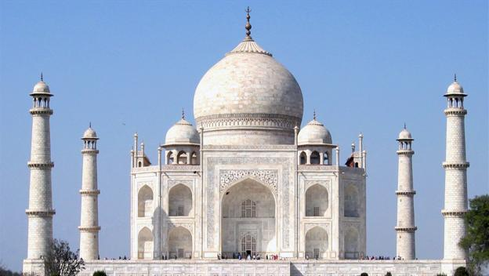
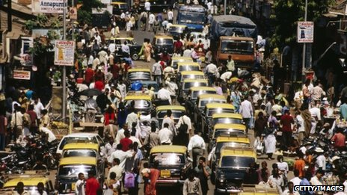
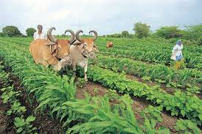
After observing the documents and images of _____________, it is clear that the elements of PERSIG are _________________ as shown by __________________________
_____________, ________________ as shown by ______________________ and ____________________ as illustrated by
__________________. Based on this evidence, I assume the culture was _______
____________________________________
____________________________________
____________________________________
___________________________________.

Slide 3
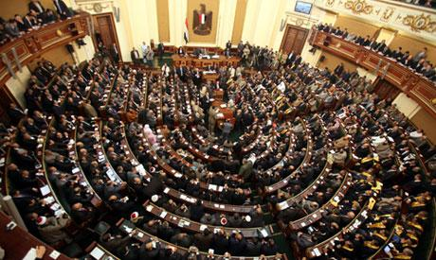
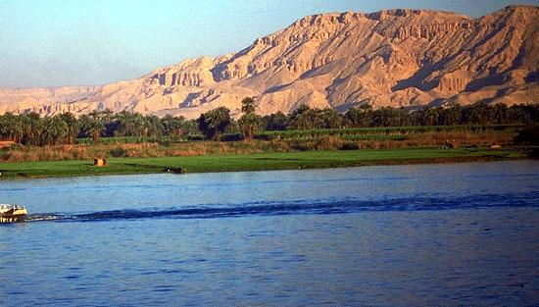
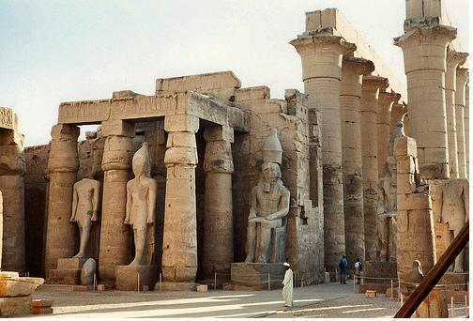
After observing the documents and images of _____________, it is clear that the elements of PERSIG are _________________ as shown by __________________________
_____________, ________________ as shown by ______________________ and ____________________ as illustrated by
__________________. Based on this evidence, I assume the culture was _______
____________________________________
____________________________________
____________________________________
___________________________________.

Slide 4
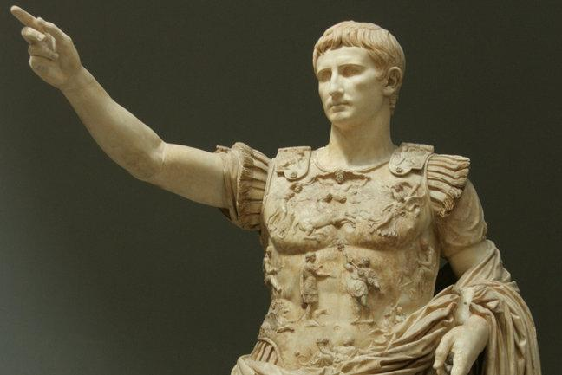
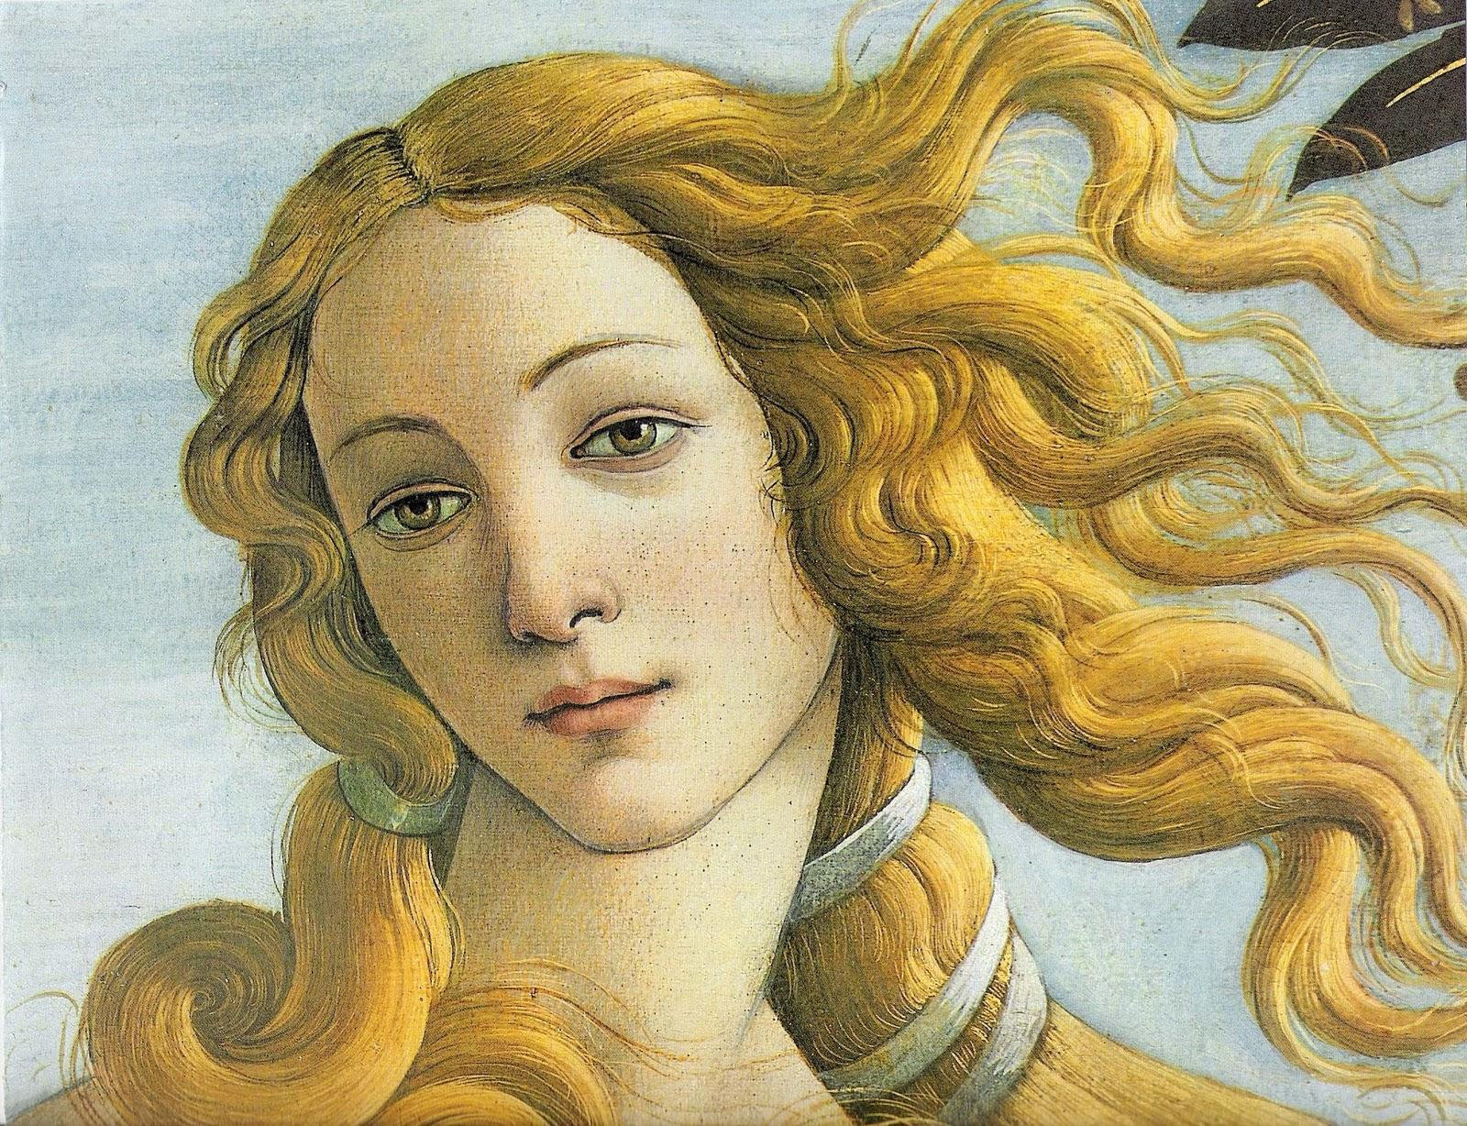
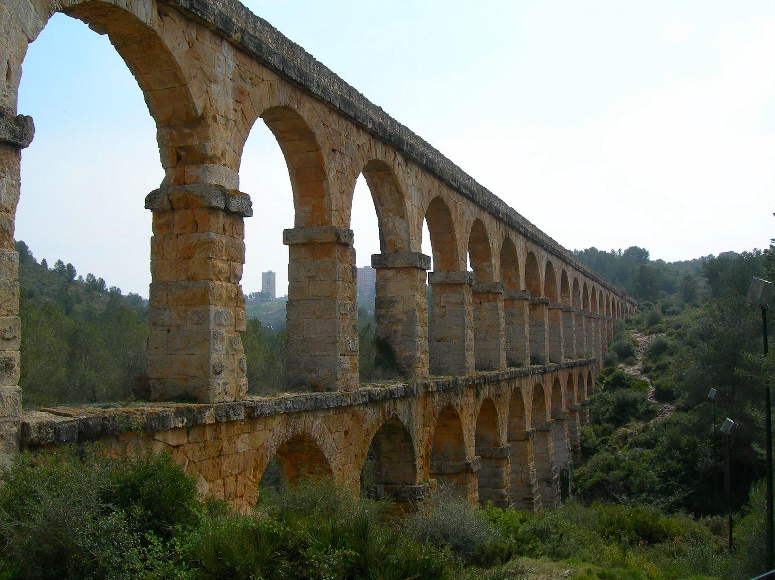
After observing the documents and images of _____________, it is clear that the elements of PERSIG are _________________ as shown by __________________________
_____________, ________________ as shown by ______________________ and ____________________ as illustrated by
__________________. Based on this evidence, I assume the culture was _______
____________________________________
____________________________________
____________________________________
___________________________________.

Slide 5
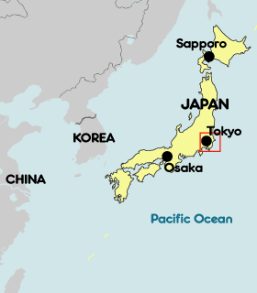
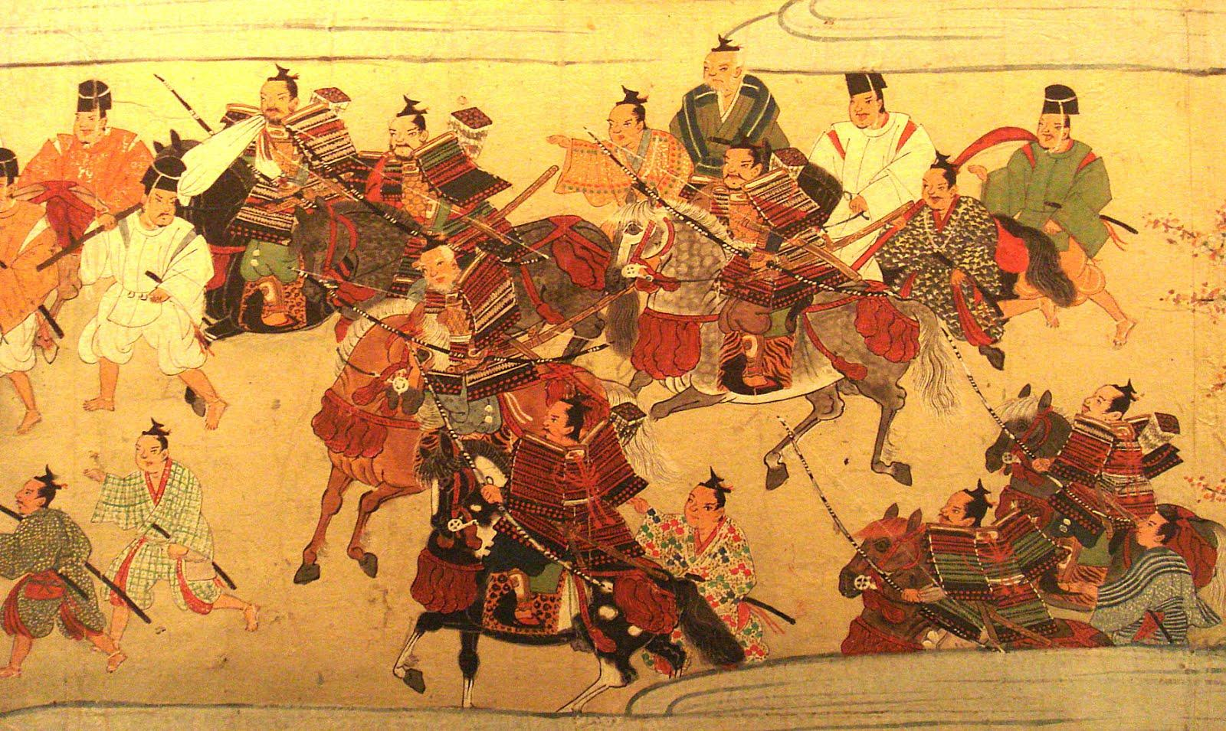
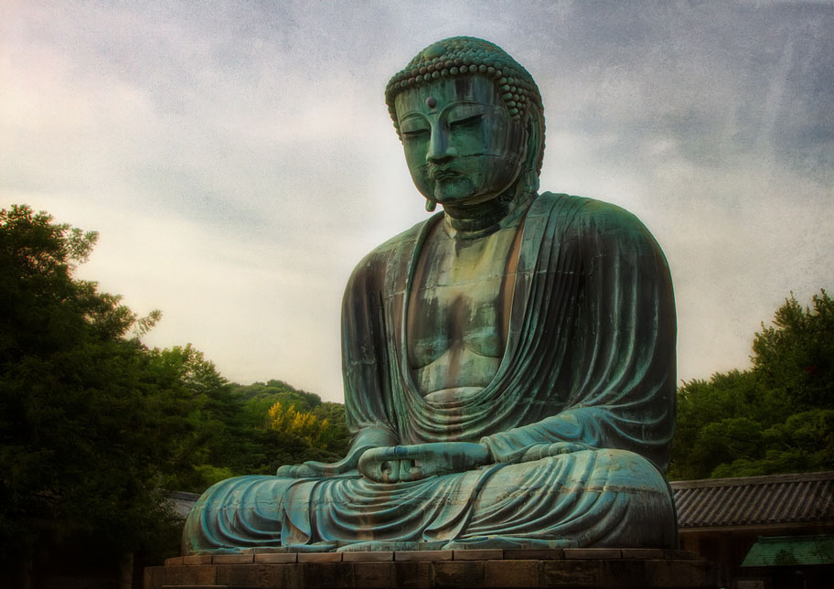
After observing the documents and images of _____________, it is clear that the elements of PERSIG are _________________ as shown by __________________________
_____________, ________________ as shown by ______________________ and ____________________ as illustrated by
__________________. Based on this evidence, I assume the culture was _______
____________________________________
____________________________________
____________________________________
___________________________________.

Slide 6
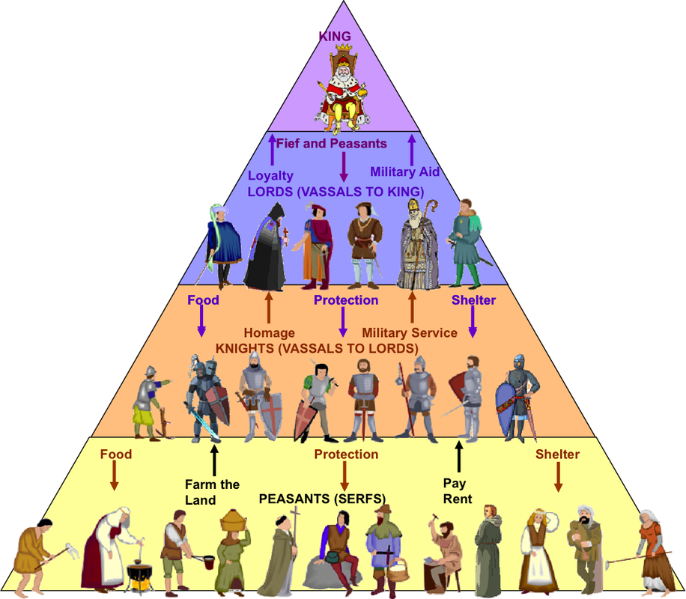
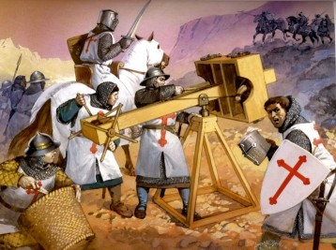
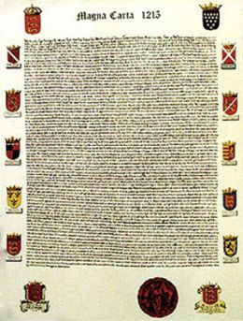
After observing the documents and images of _____________, it is clear that the elements of PERSIG are _________________ as shown by __________________________
_____________, ________________ as shown by ______________________ and ____________________ as illustrated by
__________________. Based on this evidence, I assume the culture was _______
____________________________________
____________________________________
____________________________________
___________________________________.

