Slide 1
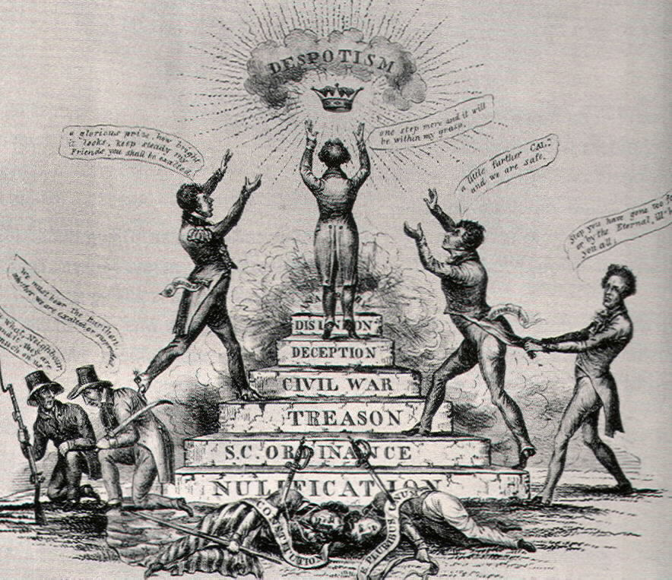
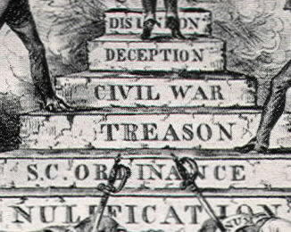
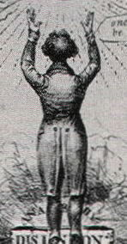
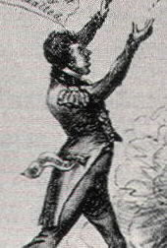
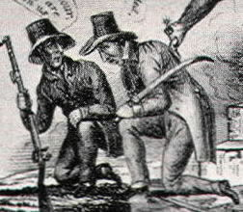
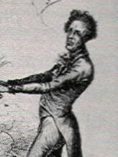
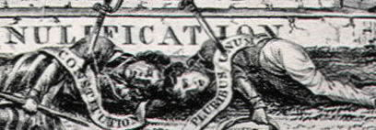
Who is this man that they are calling “Cal”?
What word is written in the explosion at his feet?
What dangerous “steps” did the man on the steps take to reach the top?
Who is this man?
What is he trying to do?
What do the dead men at the bottom of the stairs represent?
What does the artist want to say about the man at the top of the stairs?
Who do you think these men are?
What do they think about what is going on?
What is the man reaching for?
What did this mean to people in the USA in the 1800s?
What is the man doing?
Who do you think he could be?

