Slide 1
The Problems with France

Slide 2
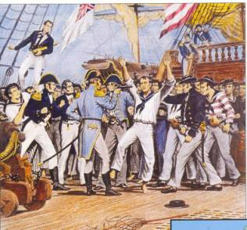
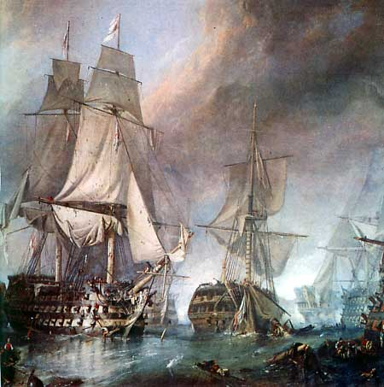
The war in Europe continued during the Presidency of John Adams.
Adams sent ambassadors to Paris to try to get the French to stop attacking American ships.

Slide 3
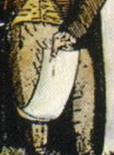
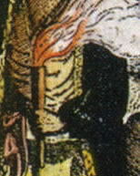
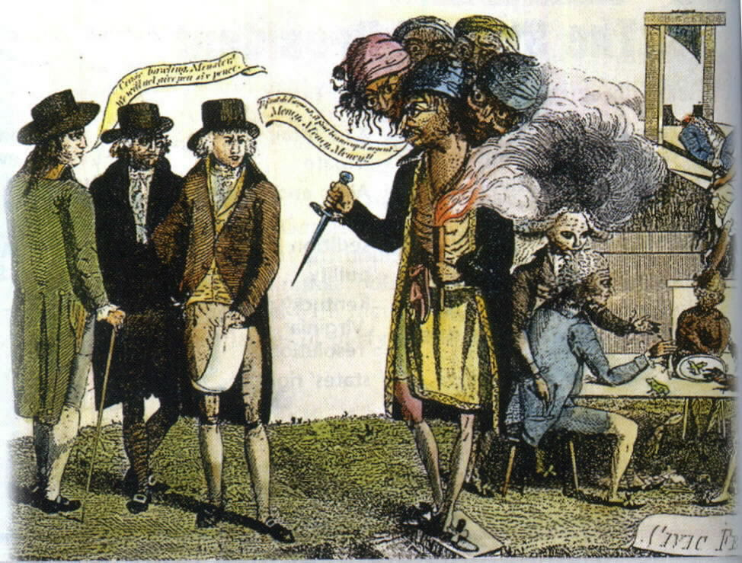
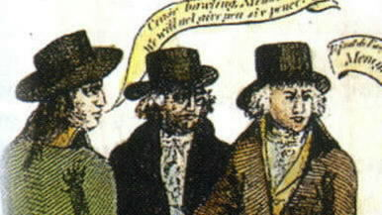
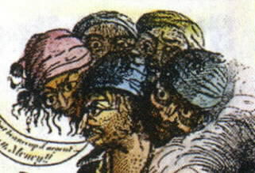
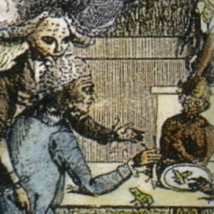
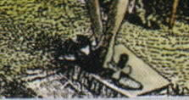
The Problems with France…
President Adams sent Americans to France to try to get a treaty to end the French attacks on American ships.
The French Representatives demanded a bribe to discuss the matter.

Slide 4
The Alien and Sedition Acts

Slide 5
Pair Share
What was the XYZ Affair? What did it result in?
Why did the Federalists in Congress make the Alien and Sedition Acts?

Slide 6
the Virginia and Kentucky Resolutions said the Alien and Sedition Acts could be ignored because they violated the US Constitution
The Alien and Sedition Acts
Federalists in Congress passed the Alien and Sedition Acts
the French representatives demanded that the USA pay them bribes before they would start to talk to them
the angry Americans returned home and ended all treaties with France – this became known as the XYZ Affair
in response to the XYZ Affair, the USA started to build its navy
states should be able to nullify (or cancel) unconstitutional laws
these were designed to increase the power of the Federalists
Adams threw a newspaper editor who criticized him in jail
Madison and Jefferson helped write the Virginia and Kentucky Resolutions
during his first year in office, President Adams sent representatives to Paris to try to settle the “undeclared war” that was being fought with France

Slide 7
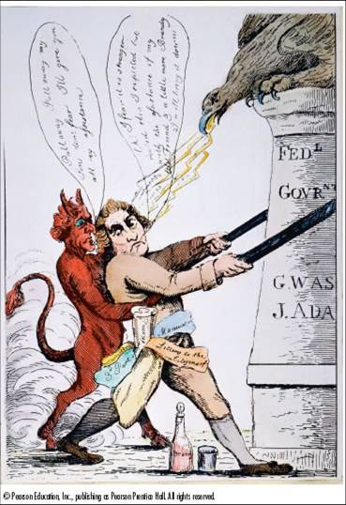
Alien and Sedition Acts
“Oh! I fear it is stronger rooted than I expected, but with the assistance of my old friend and a little more Brandy (alcohol) I will bring it down.”
What is Jefferson doing?
building the government
destroying the government
making a deal with the devil
hunting eagles
Is the artist sympathetic to Jefferson?
yes
no
can’t tell
the artist likes Jefferson, but not this action
Where do you think this cartoon would have appeared?
in a magazine
in a newspaper
on television
overseas
The artist would agree with the
government’s right to silence criticism.
First Amendment.
devil.
idea that people can bring down governments.
“Pull away. Pull away my son. Don’t fear I’ll give you all my assistance.”

Slide 8
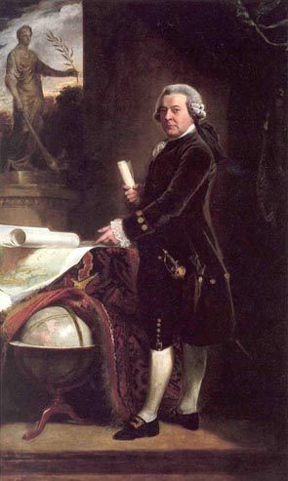
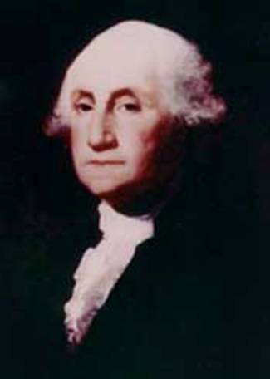
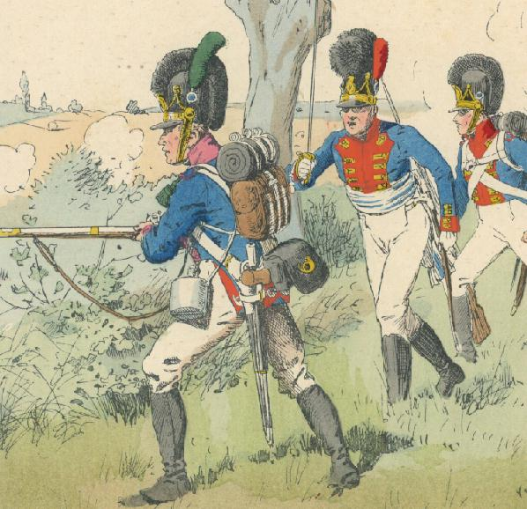
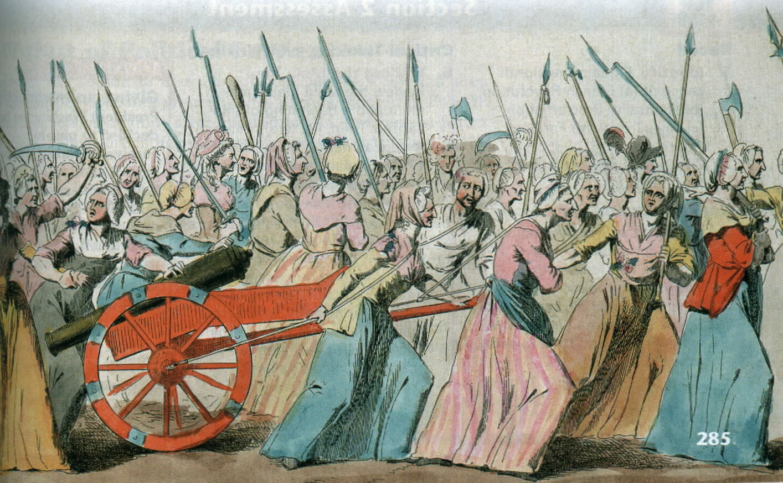
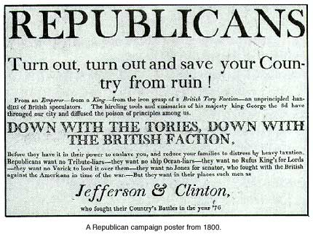
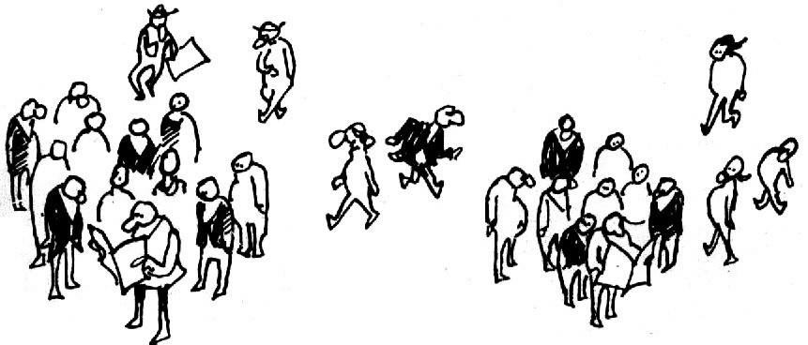
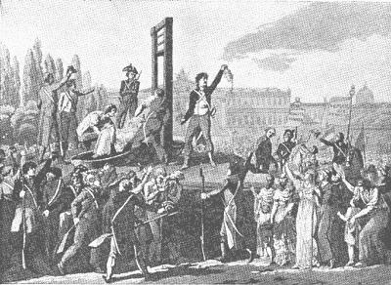
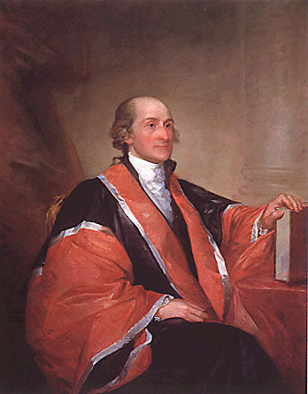
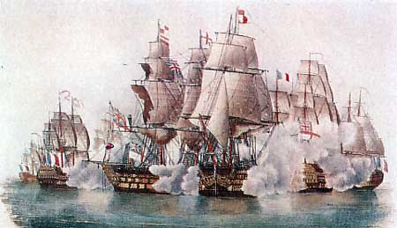
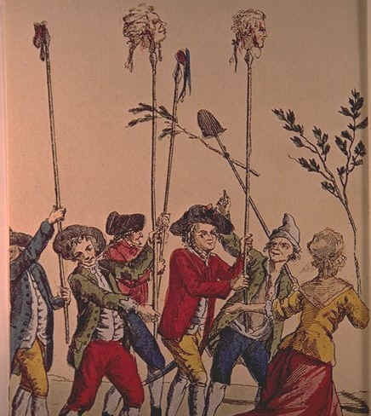
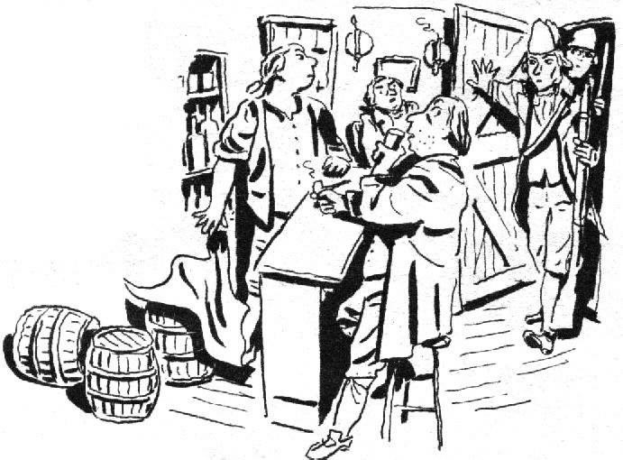
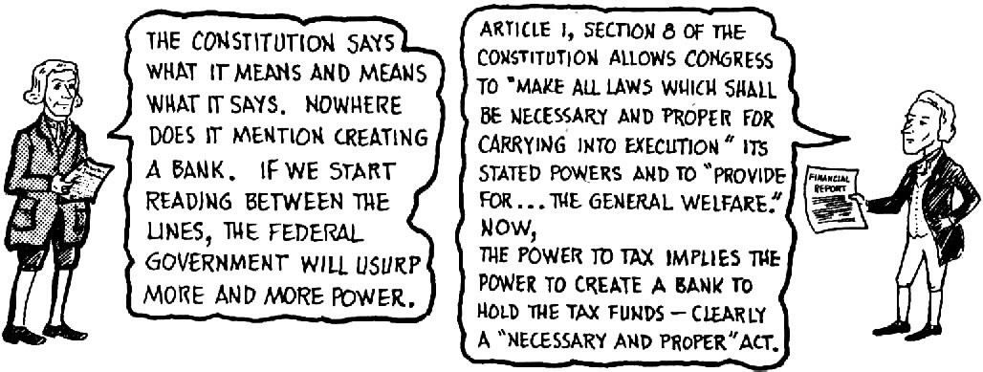
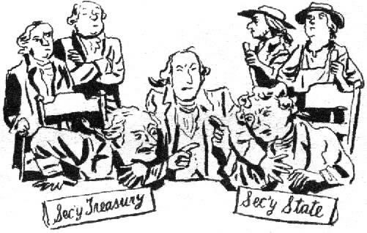
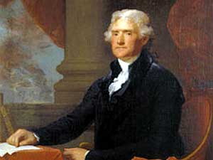
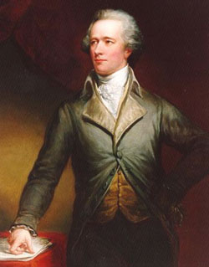
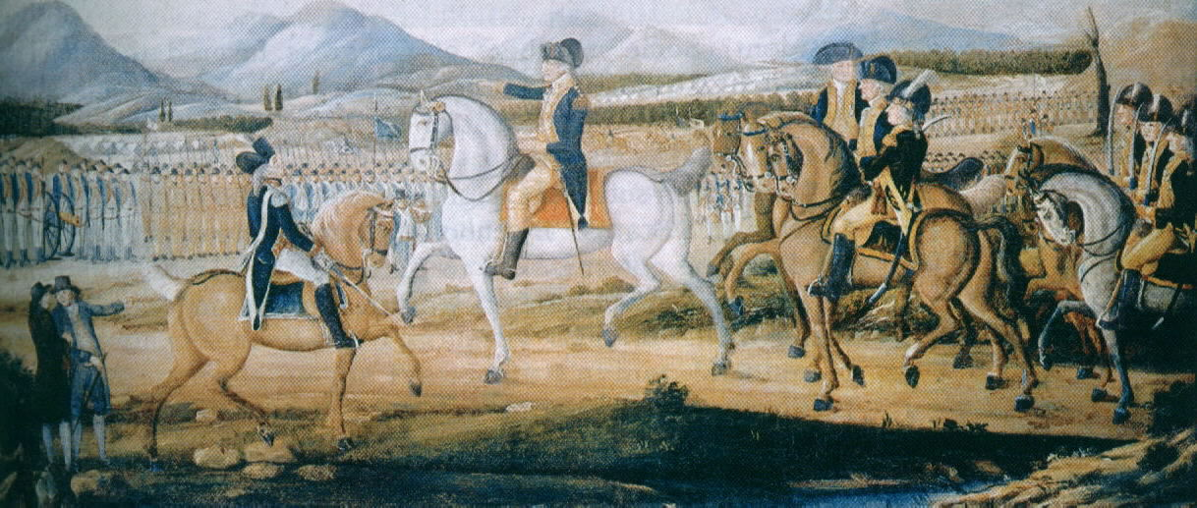
Congress creates Bank of the USA
Washington makes Neutrality Proclamation
Alien and Sedition Acts
Washington becomes 1st President
Whiskey Rebellion
Jay’s Treaty keeps peace with Britain
John Adams becomes 2nd President
1789 1790 1791 1792 1793 1794 1795 1796 1797 1798
French Revolution begins
French Revolution becomes violent
War in Europe
XYZ Affair
President Washington realizes that he needs help running the government. He asks different men to help him run the country.
Jefferson and Madison respond to the Alien and Sedition Acts by trying to get Kentucky and Virginia to declare the laws unconstitutional.
They get the Kentucky and Virginia Resolutions passed.
Newspapers start criticizing President Adams. They also divide American opinions.
To punish Republicans (Jefferson’s followers), Federalists pass the Alien and Sedition Acts.
Adams sends diplomats to France to get an end to French attacks on US ships.
The French agents demanded a bribe.
Armies from across Europe attack France to end the Revolution.
Unfortunately the two men argue about everything.
Washington asks Alexander Hamilton to run the USA’s economy.
Washington sent John Jay to make a peace treaty with England.
Both Britain and France want the USA’s support.
Both start to attack US ships to force the US to choose sides.
Farmers in Pennsylvania started a rebellion. Washington personally led the army to end the rebellion.
He asks Thomas Jefferson to run the USA’s dealings with foreign countries.
European monarchs fear the example of the French Revolution.
To raise money to pay the debt, Hamilton gets Congress to make a new tax on whiskey.
How much power does the Constitution give the government?

