Slide 1
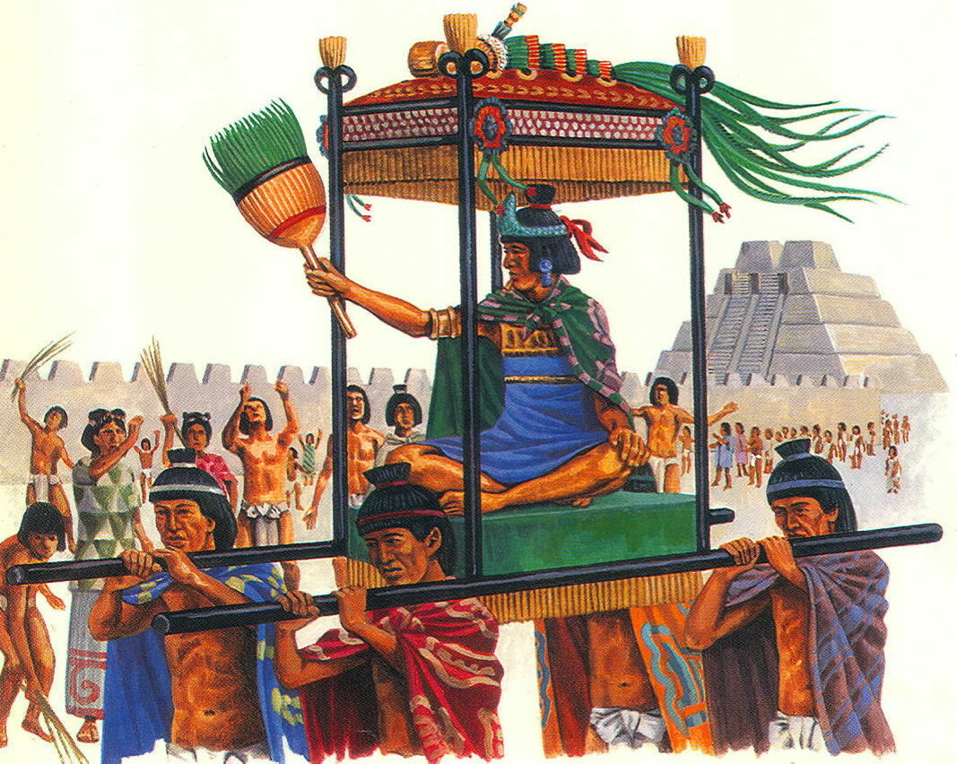
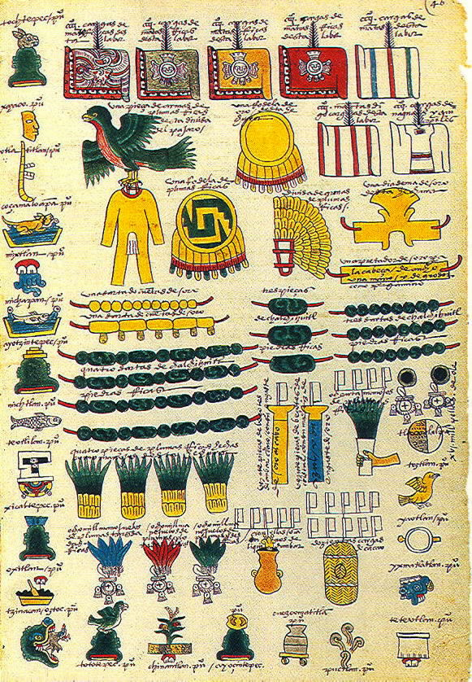
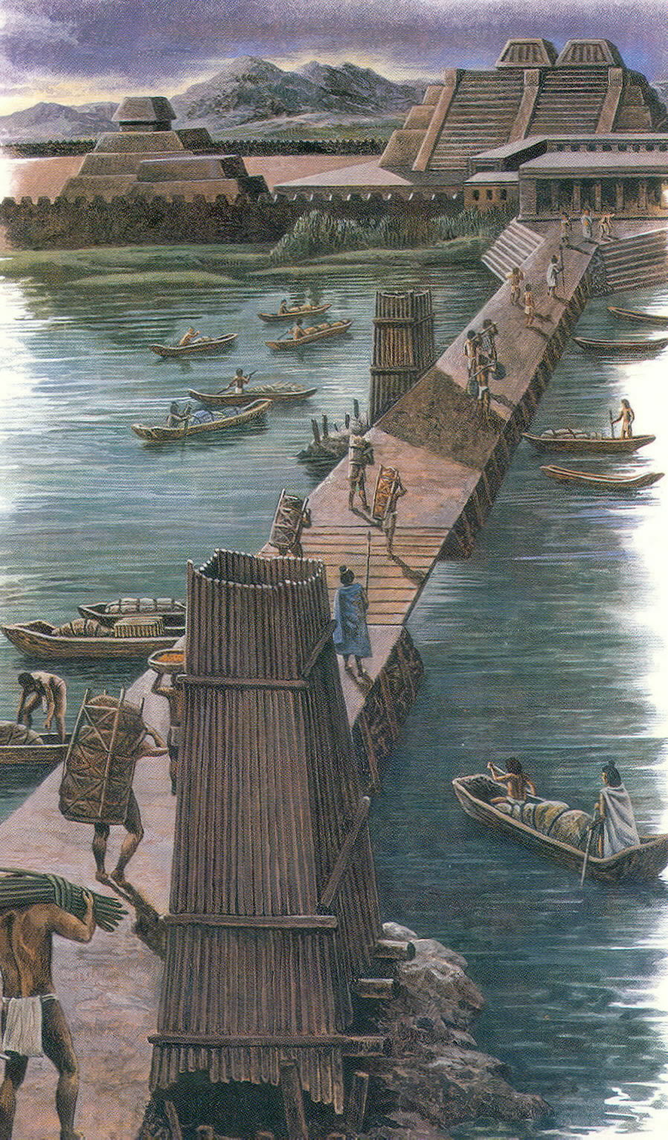
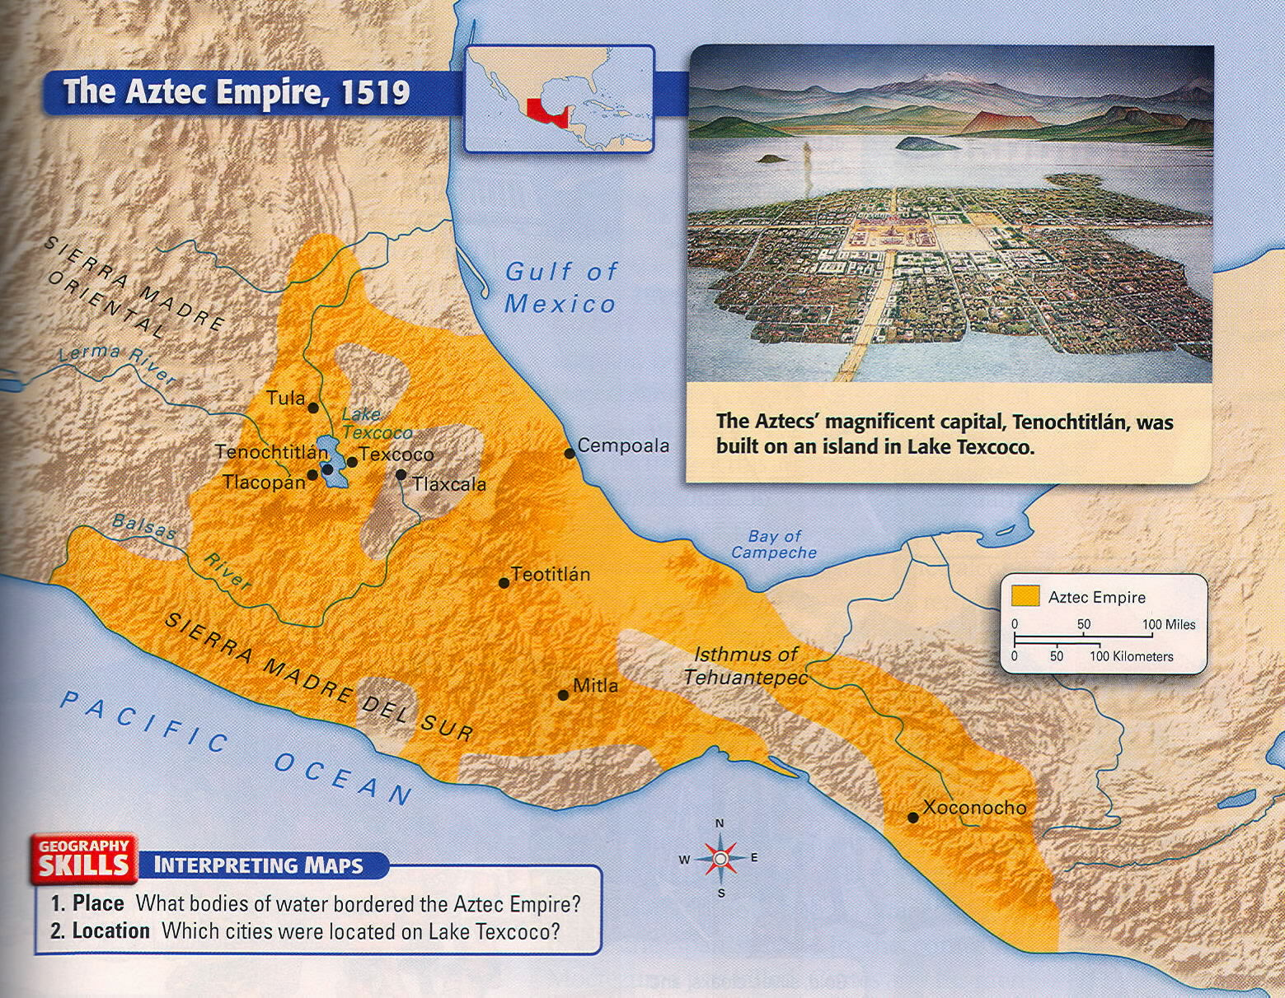
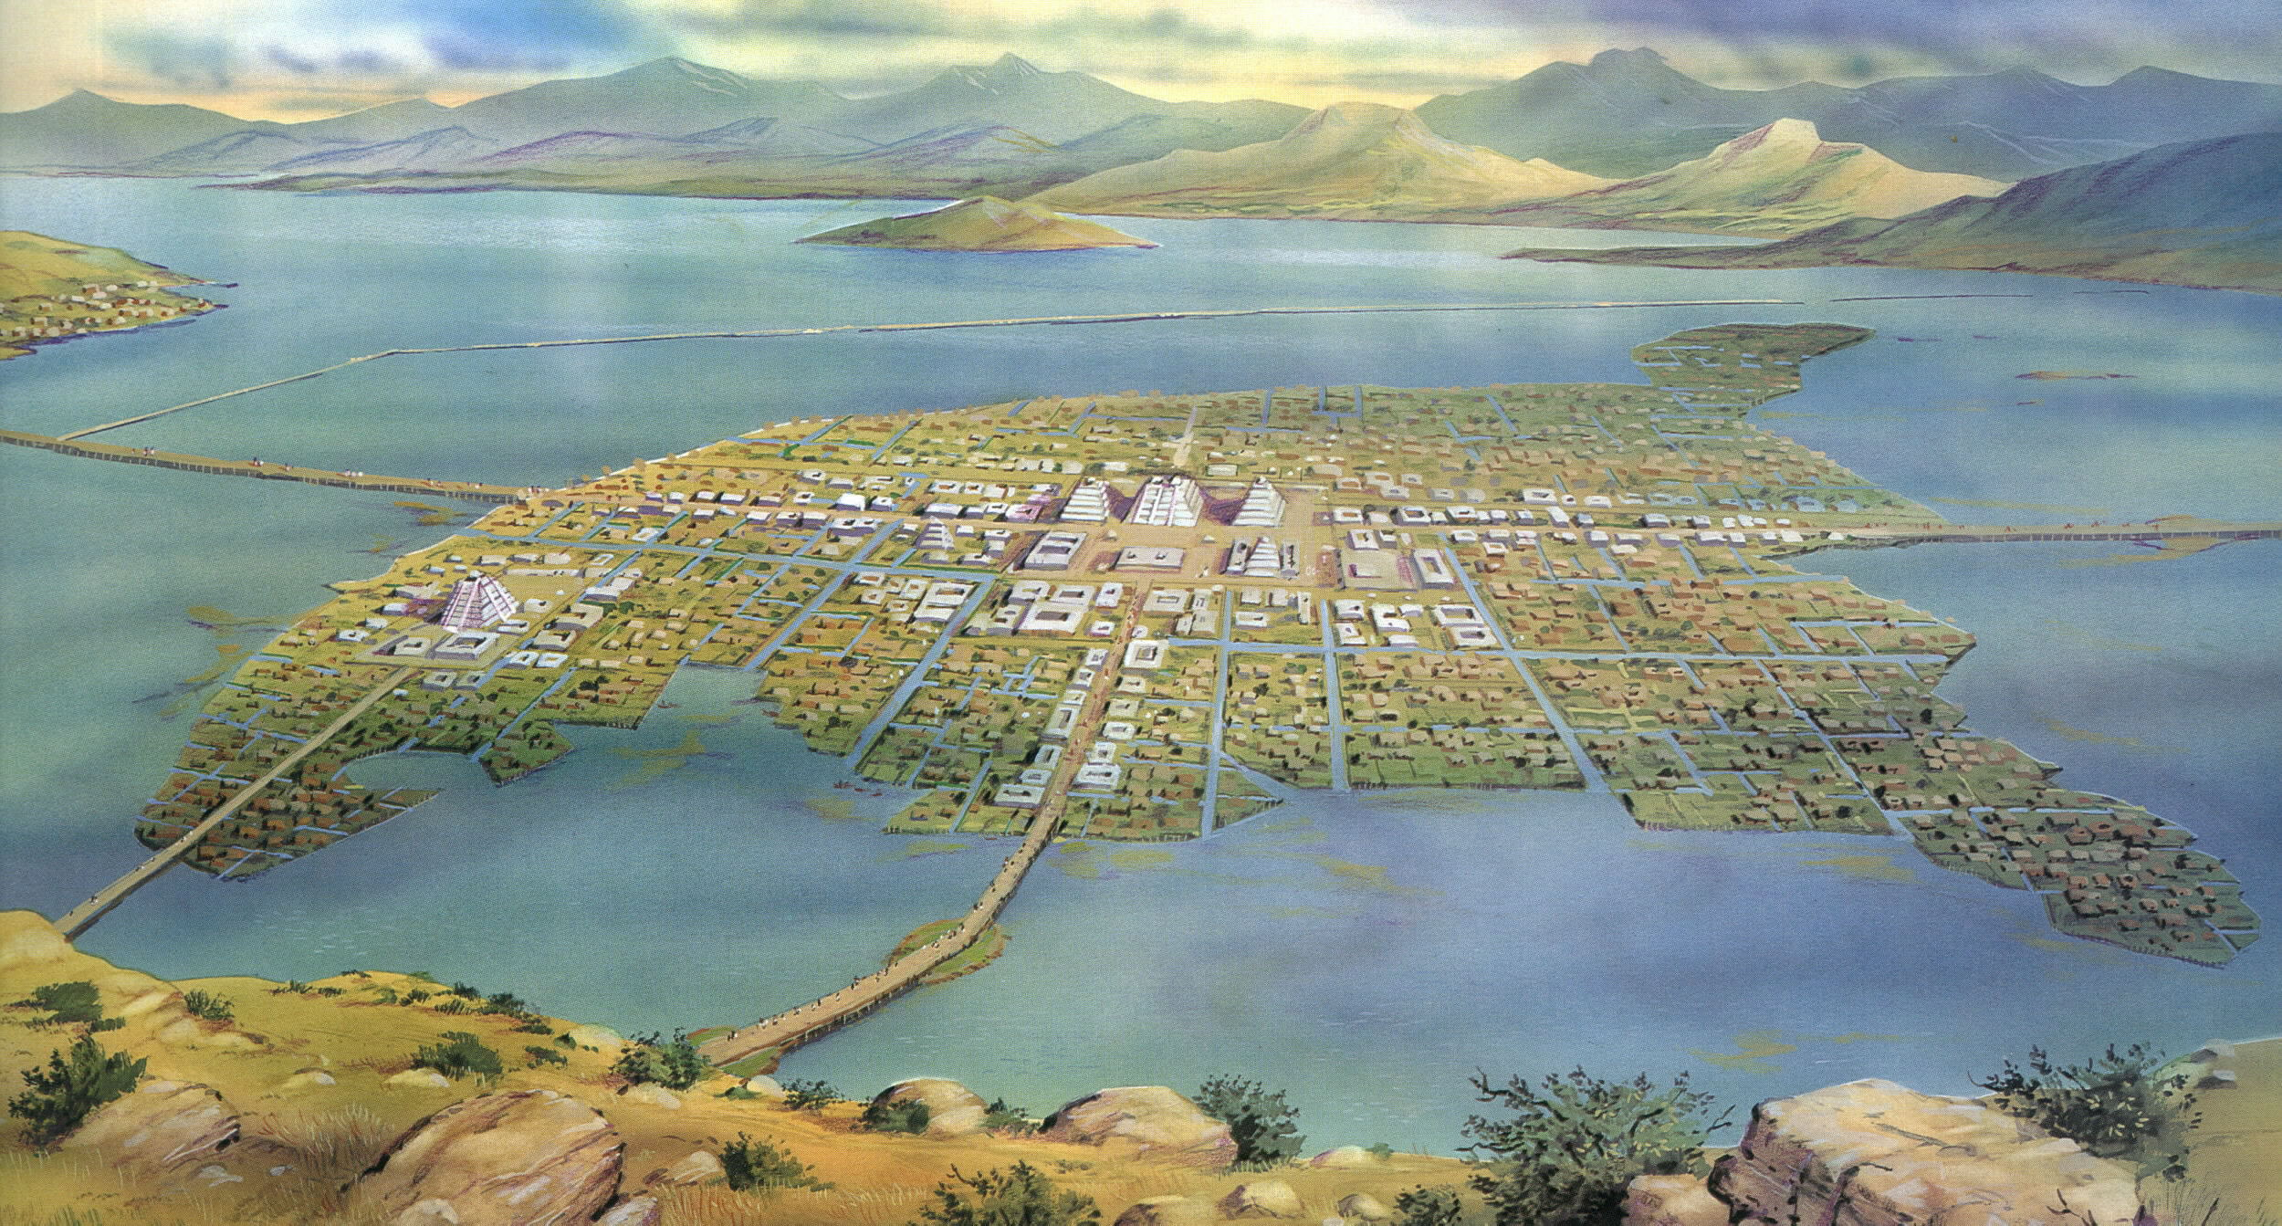
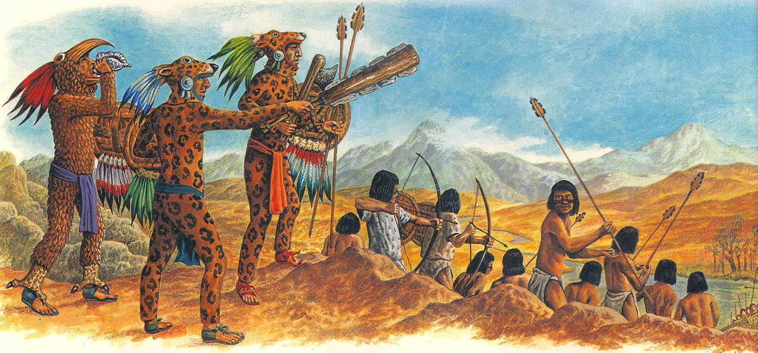
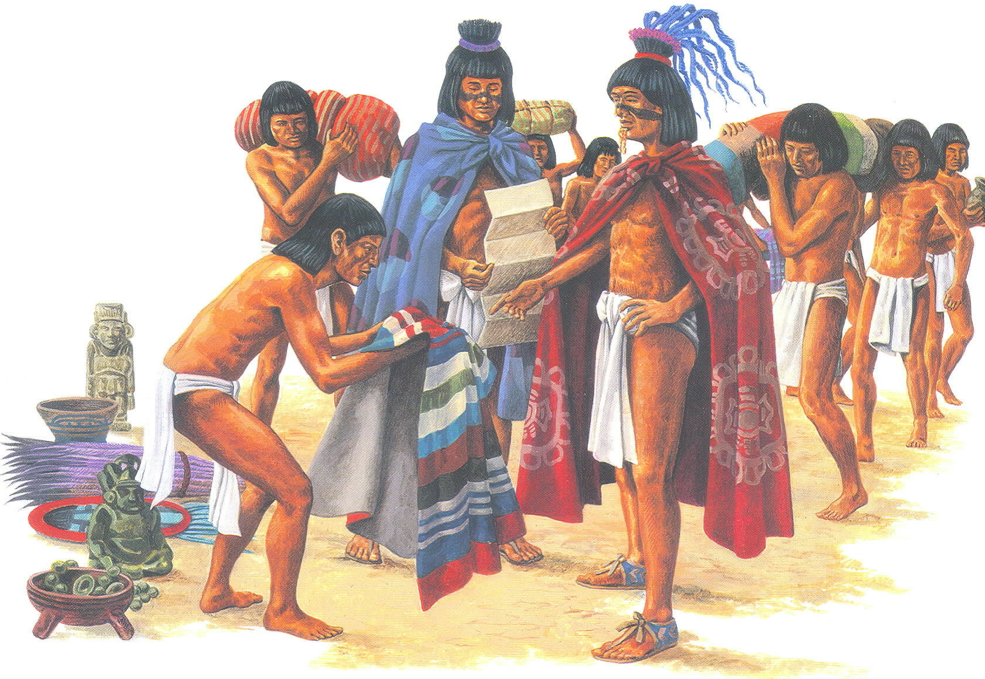
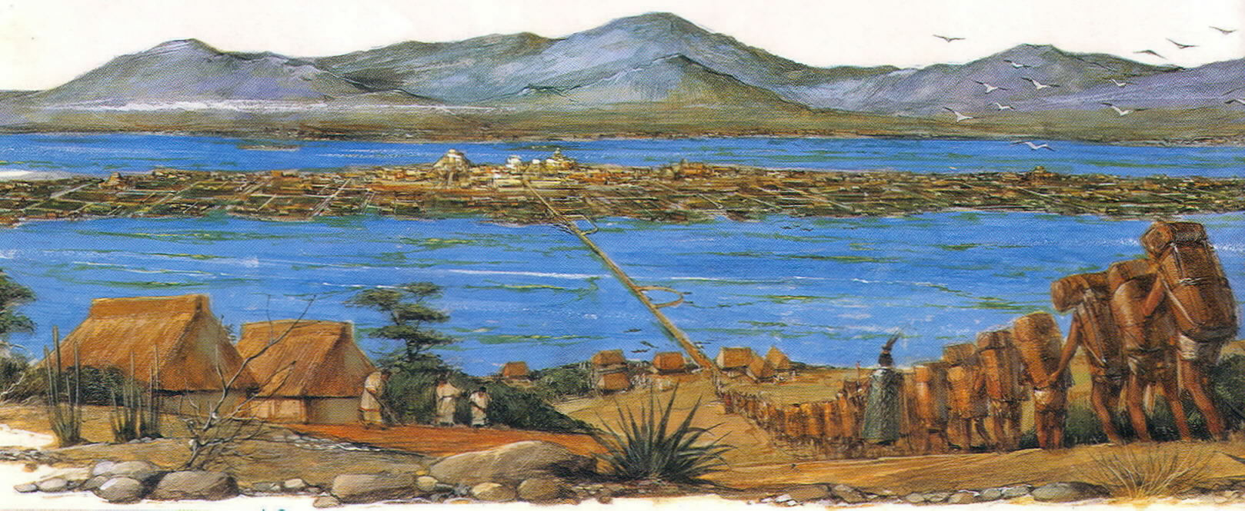
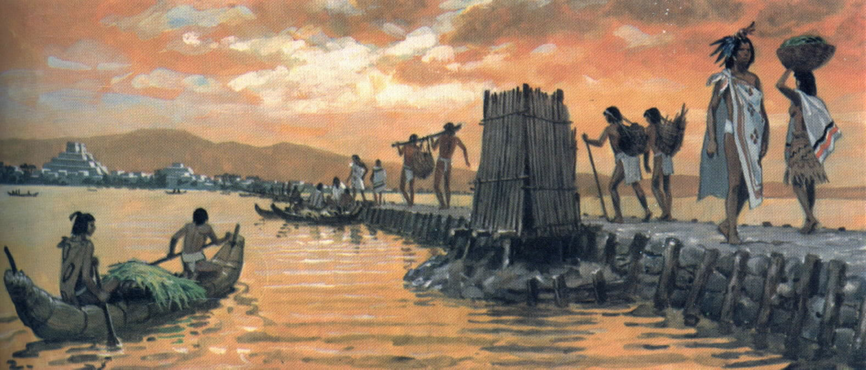
Growth of the Aztec
By 1440, Moctezuma I had risen to become emperor to the Aztec.
The Aztec were excellent soldiers and they went to war. The Aztec conquered the other tribes in the Valley of Mexico, and Tenochtitlan became the center of a large and powerful empire.
As the empire grew, conquered people were not required to become Aztec. They could keep their language, religion, and even leaders.
At the center of the Aztec empire was the wonderful city of Tenochtitlan.
When the Spaniards arrived in 1519 AD, Tenochtitlan was twice as big as any European city.
Conquered people could not become Aztec. They were forced to pay heavy tribute (taxes) to the Aztec.
Tribute would also include people for sacrifice…

Slide 2
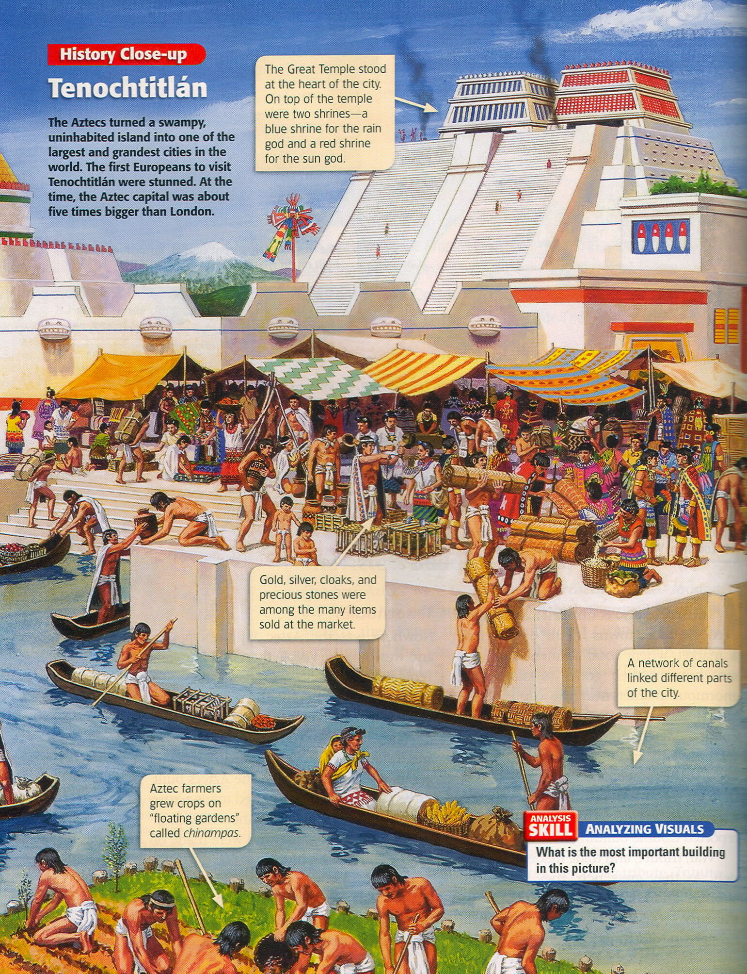

Slide 3
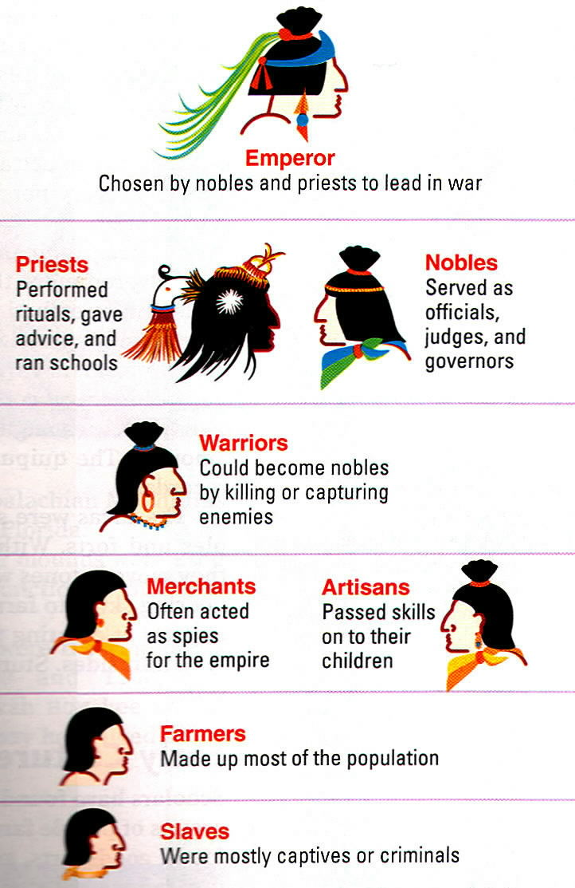
Social Structure
noble class – emperor, government officials, military commanders, priests, rich land owners
middle class – merchants and artisans
lowest class – farmers, fishermen, soldiers, slave

Slide 4
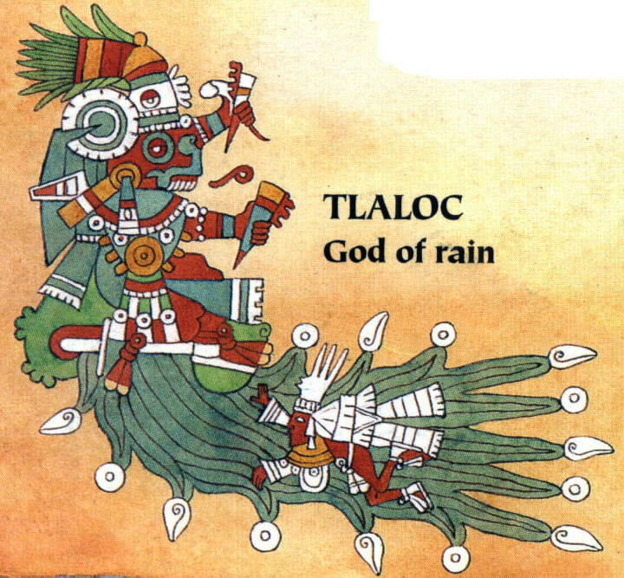
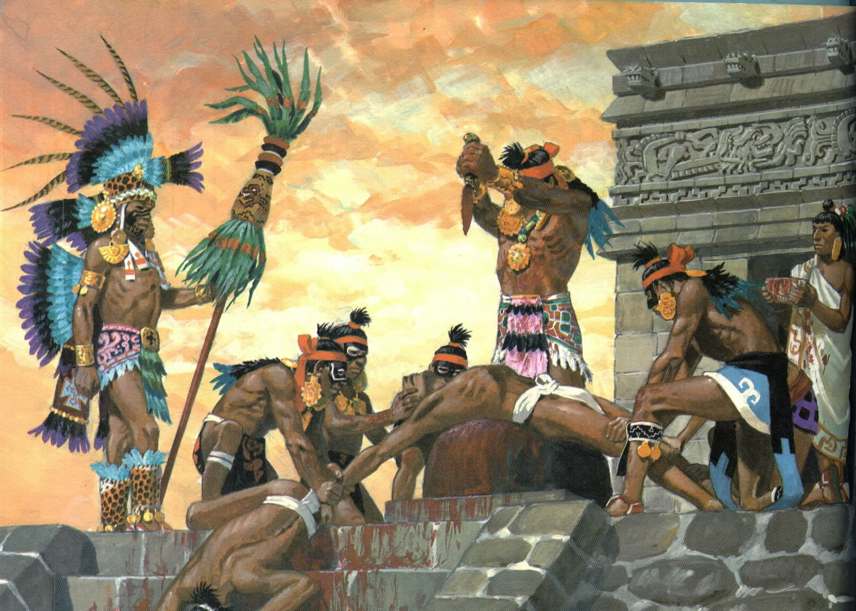
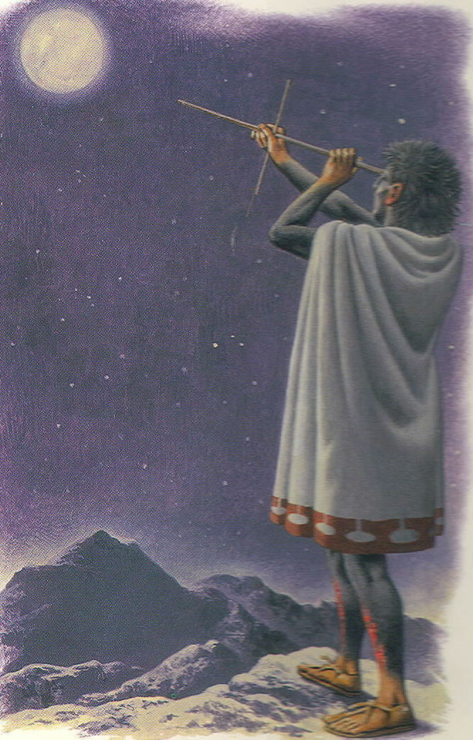
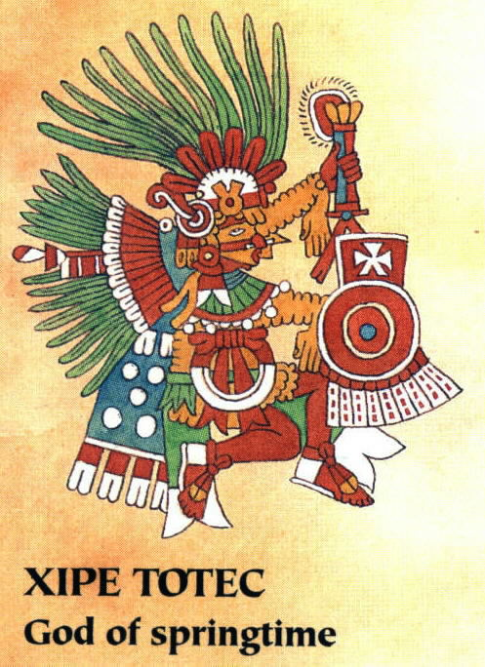
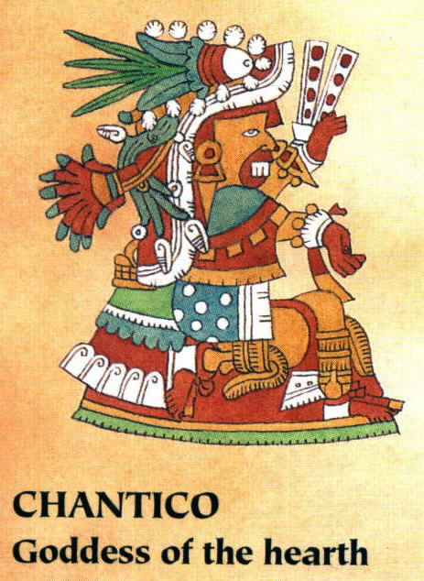
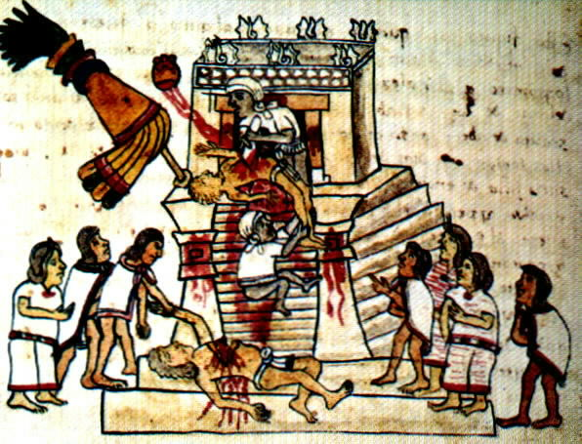
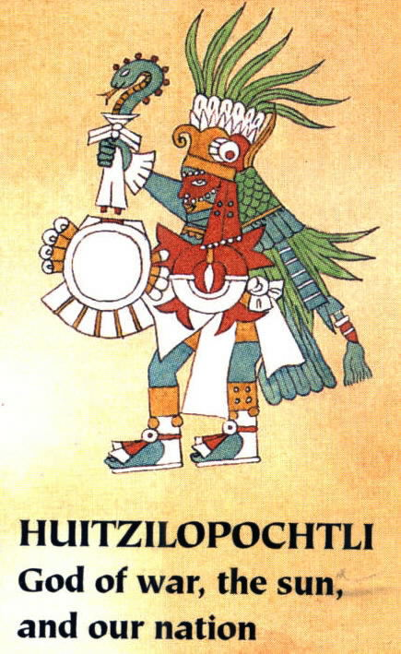
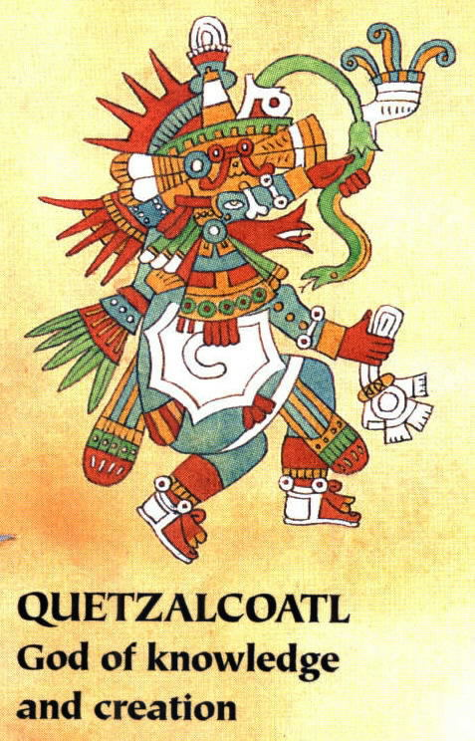
Aztec Religion
The Aztec priests were also responsible for making sure that the sun rose every morning by sacrificing humans to the gods.
The Aztec believed in many gods.
They also believed that the world was created and destroyed regularly.
The universe (in the 1400s and 1500s) was in its fifth incarnation.
Quetzalcoatl created all people by shedding his blood on the bones of the people who died during the fourth creation of the world.
The Aztecs sacrificed people because the sun needed blood to rise.
Aztec priests were great astronomers, who inherited much of their knowledge from earlier civilizations.

Slide 5
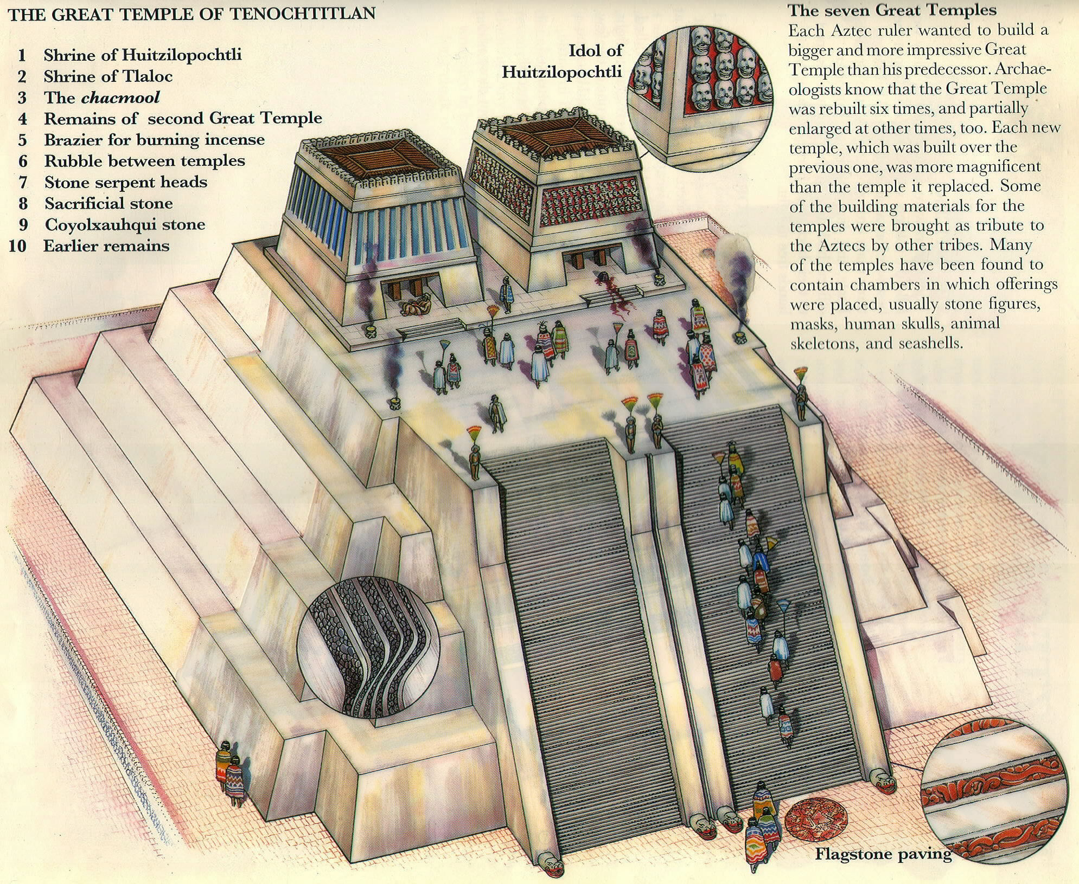
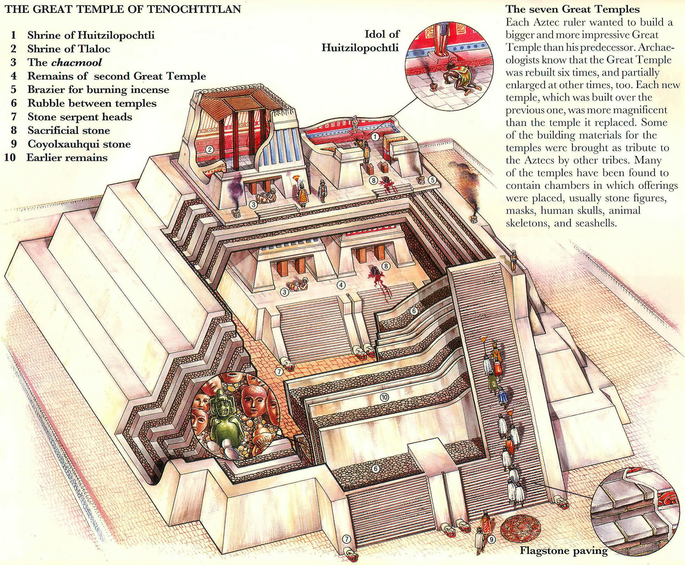

Slide 6
