Slide 1
The Aztec

Slide 2
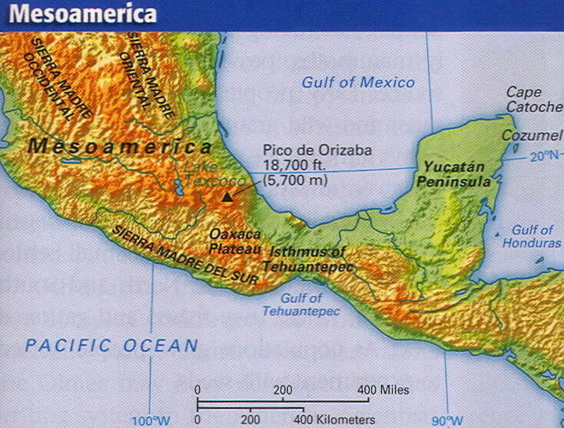
The Aztec
The Aztec came from present day Texas .
They were the last tribe to move into the valley of Mexico.

Slide 3
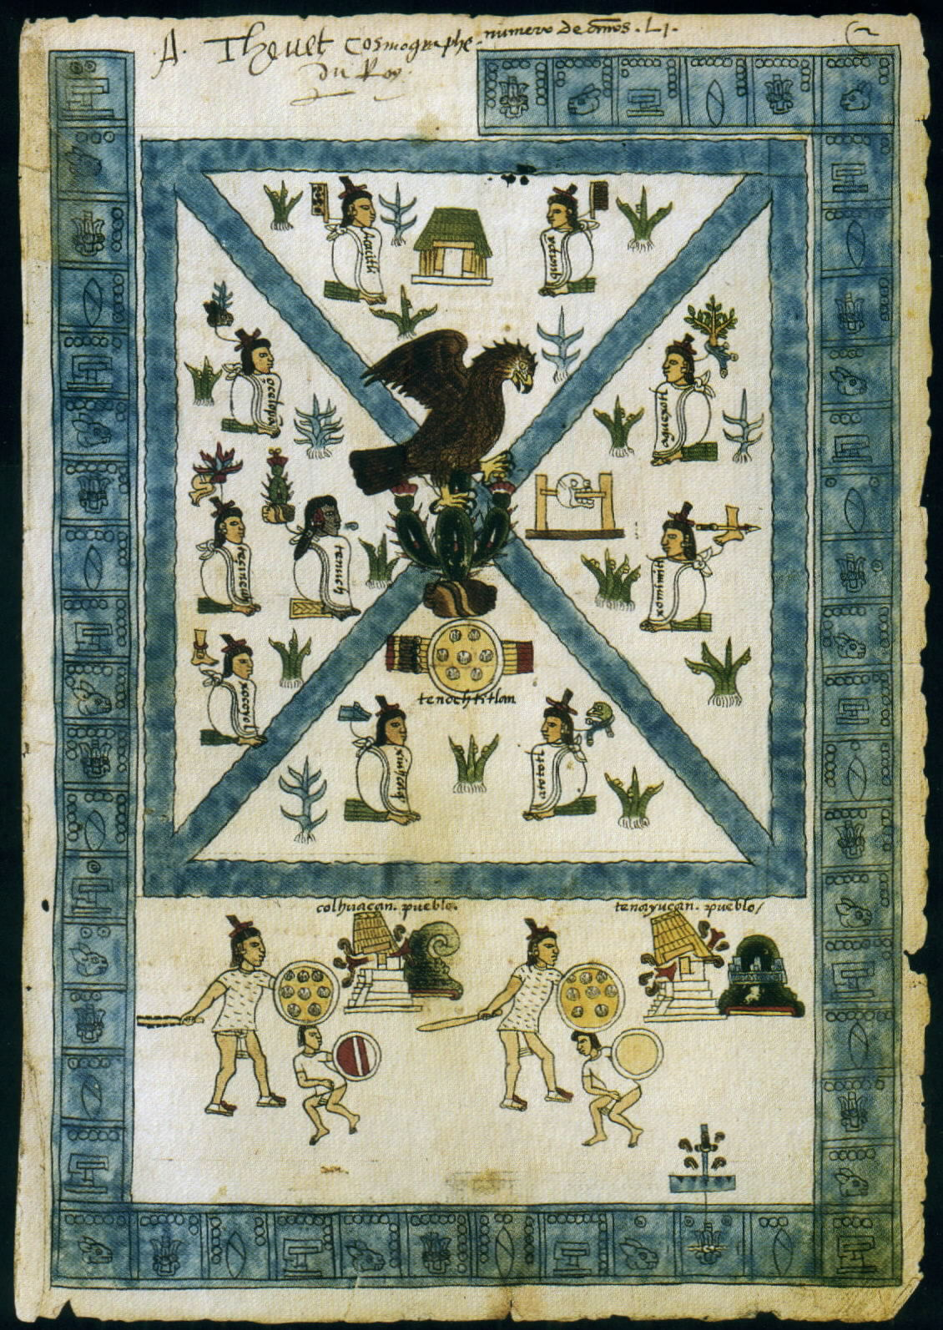
The god Huitzlipochtli told them to move until they found an eagle sitting on a cactus eating a snake.
After hundreds of years they saw their sign on an island in the swamp of Lake Texcoco.
On that site they founded their capital city, Tenochtitlan.

Slide 4
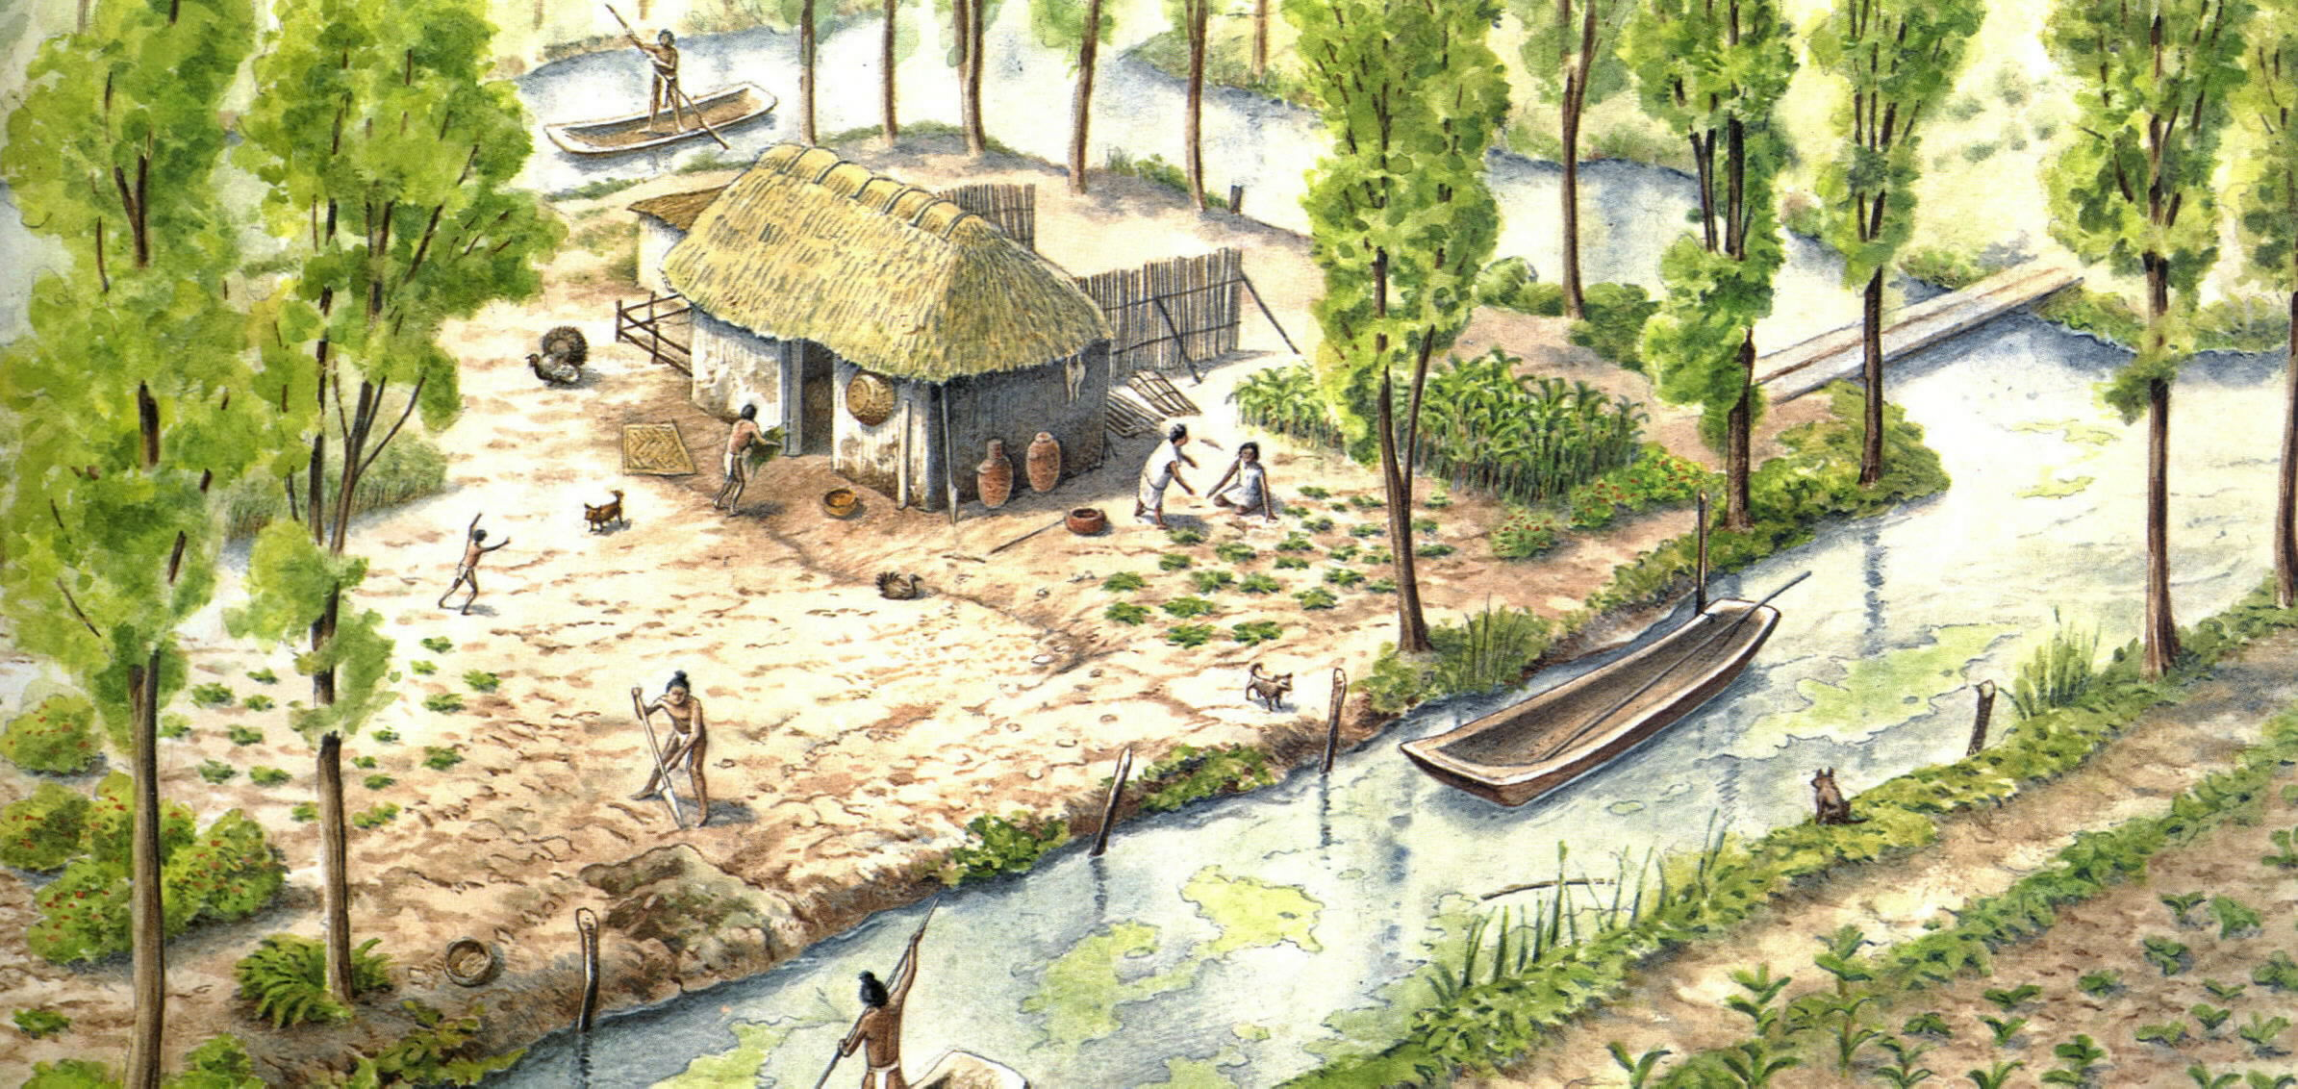
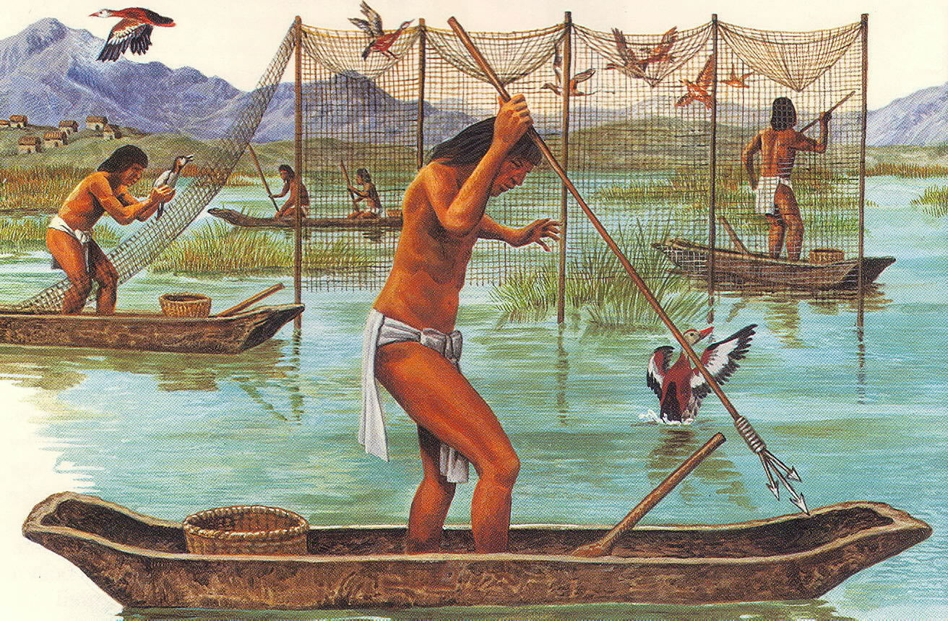
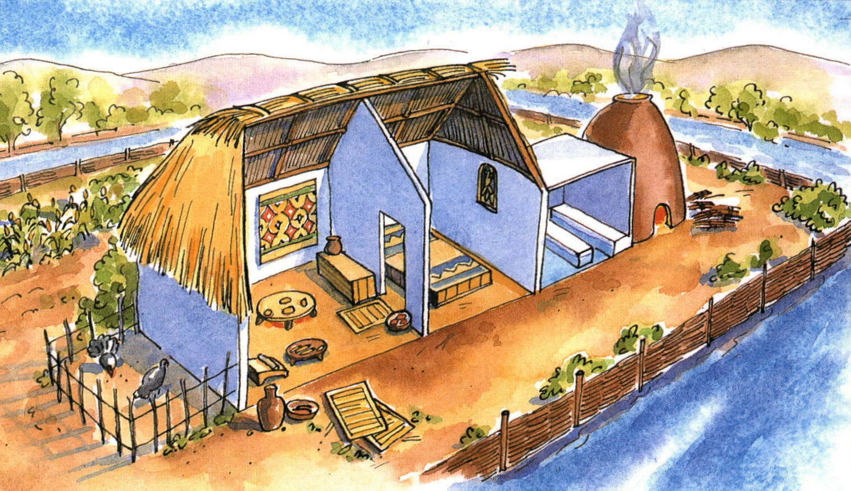
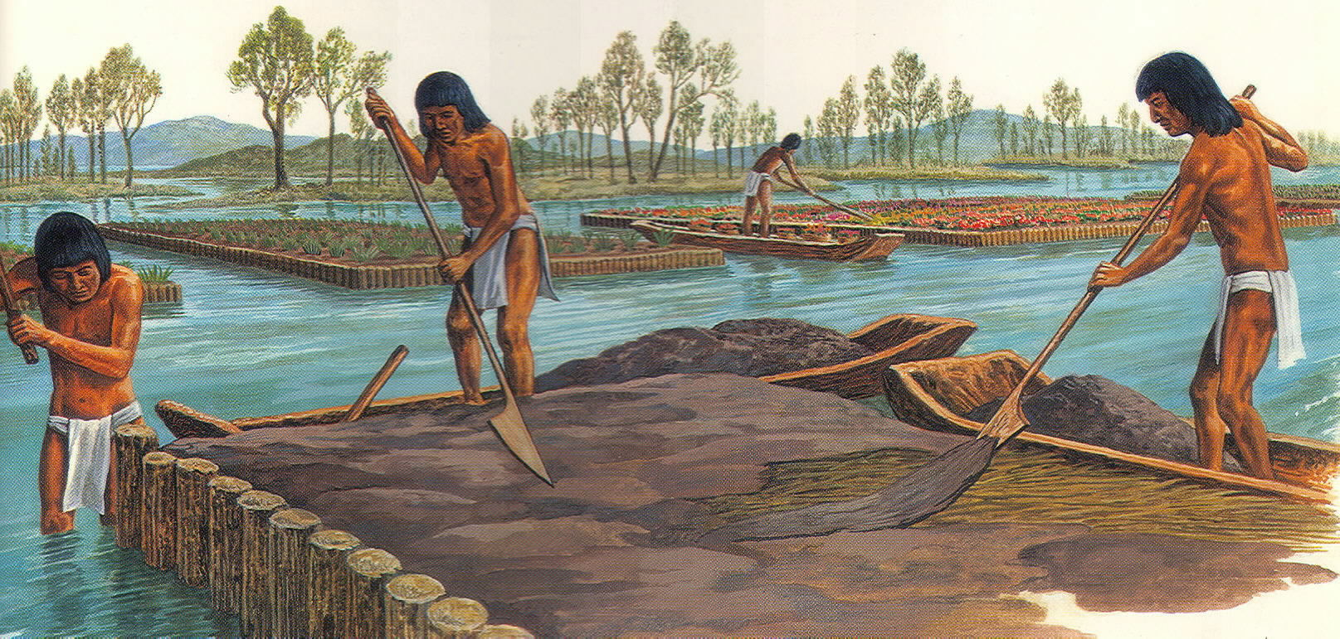
Adapting to the Environment
The Aztec were forced to live in the worst land.
At first they fished, hunted birds, and ate snakes in the swamps of Lake Texcoco.
But, as time passed, the Aztec learned how to transform the swamps into fantastic gardens.
Aztec farmers started to make chinampas, or floating gardens.
Chinampas became the basis of Aztec life.

Slide 5
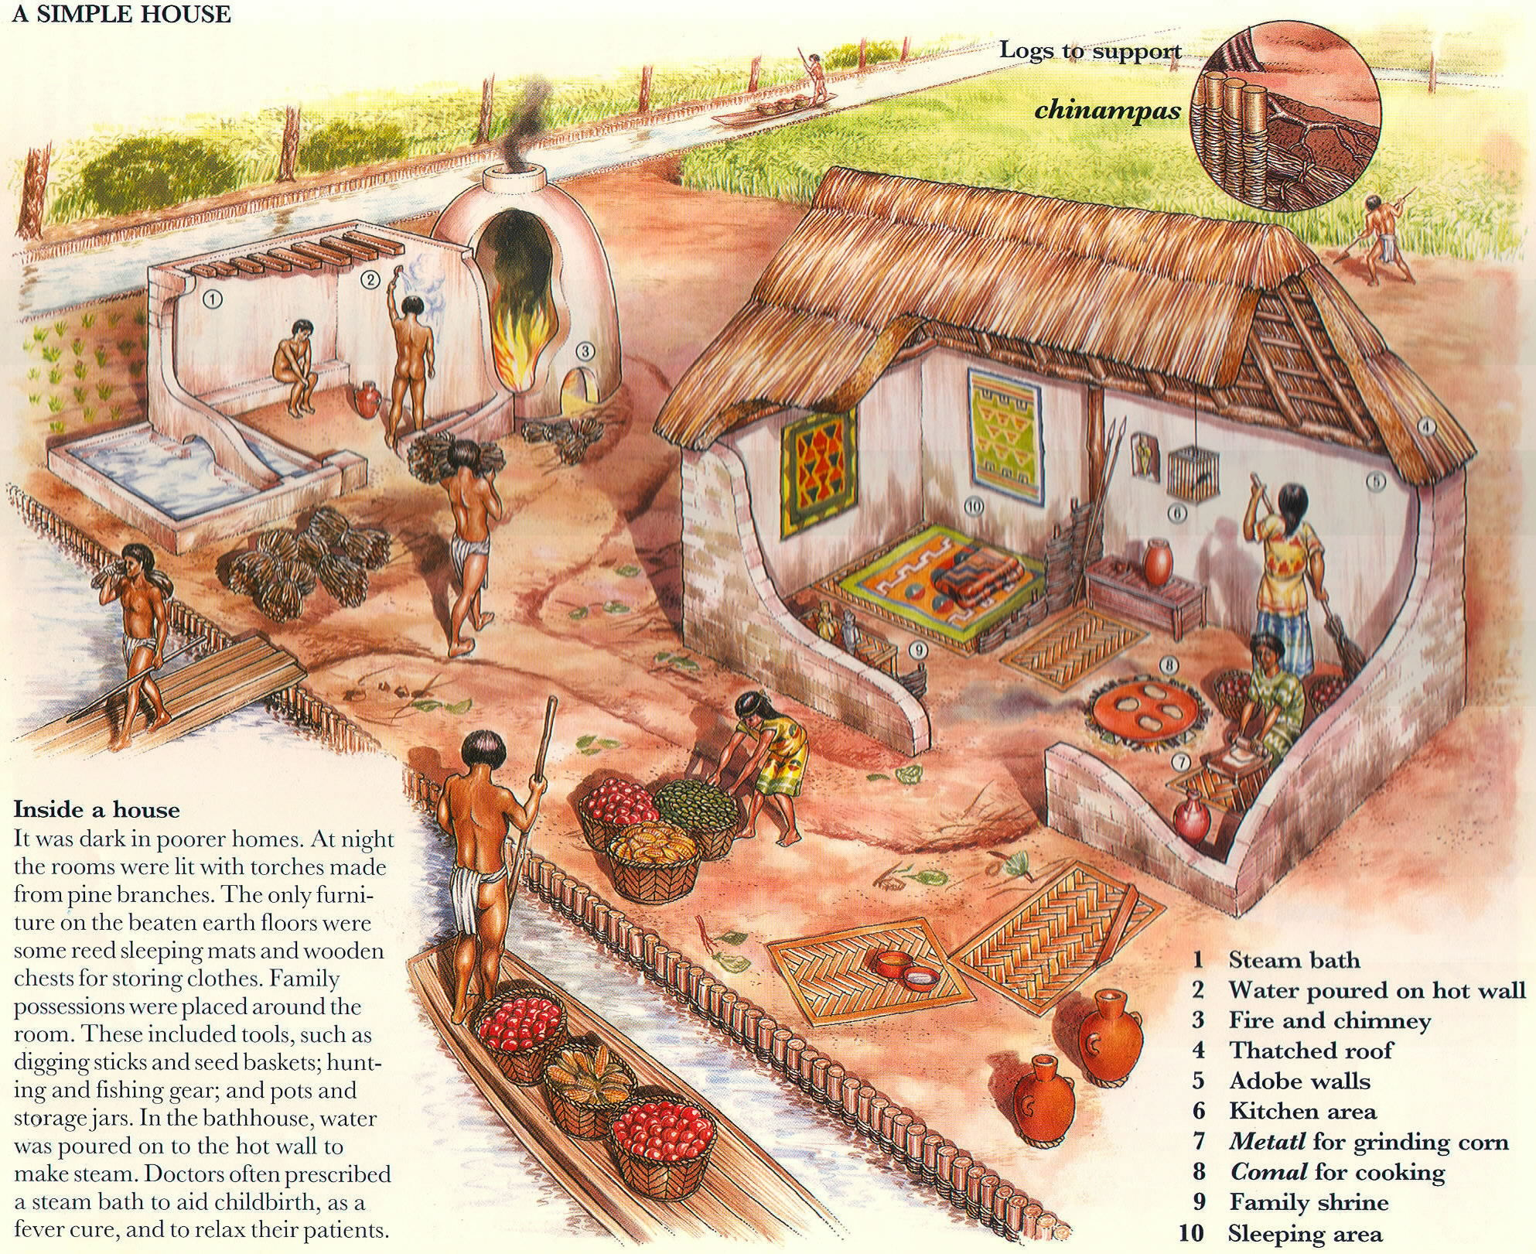

Slide 6
